Slide 1
UNCLASSIFIED
Meta-Art: Using Metadata Thumbnails
to Maximize Analysis Support
Eric Robeck, NGA/SFNEE
12 August 2020
UNCLASSIFIED
UNCLASSIFIED

Slide 2
Introduction
UNCLASSIFIED
Thumbnails allow analysts to check reliability of quality metrics, and to identify probable error locations.
Uses are not limited to shaded relief – effective for assessing quality, source data, water bodies, slope, urban development, etc.
SFNE (Source Foundation Elevation) Division has optimized thumbnail styling, already in use for DGED data.
Multiple thumbnails can be viewed in a web browser using the NSG Elevation Metadata Implementation Specification (NEMIS) XML template.
Transparency highlights void areas and supports overlay with other datasets.
Point cloud thumbnails can be expanded from standard color and intensity.
UNCLASSIFIED

Slide 3
Why are Thumbnails Important?
UNCLASSIFIED
Metadata is critical for cataloguing the exploding quantity of 3D, high-resolution elevation data in the cloud, supporting data searches, and relaying critical accuracy information for analysis.
Files are complex, and often overlooked by analysts who may benefit from additional detail.
Quality metrics like LE90 cannot account for dataset variability and are often inaccurate, particularly in datasets containing voids and noise.
SFNE and ATSCL are creating metadata thumbnails for viewing in GRiD prior to download.
The benefits of metadata thumbnails include:
expanded quality control
improved search results
reduced download quantity
increased metadata utility
They allow GRiD to support NGA's mission to provide the best quality 3D data to its clients.
UNCLASSIFIED

Slide 4
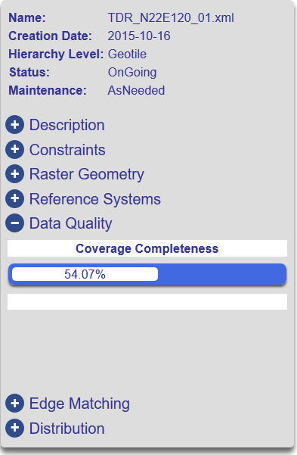
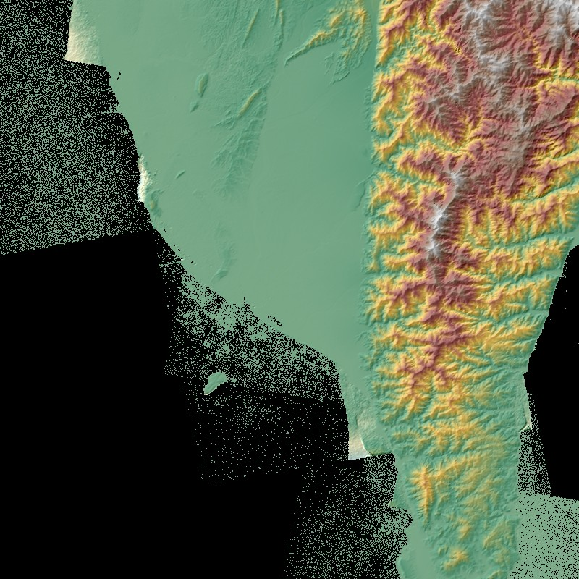

TanDEM-X Raw (TDR): Thumbnail Shows Quality Metrics Are Inaccurate
UNCLASSIFIED
120° E
121° E
23° N
Reported LE90 from ICESat is low, but thumbnail reveals…
cell values >1 km below sea level
locations of >50% void cells
water surface noise
shoreline edge defects
3118 m
Vertical Accuracy (Difference to ICESat)
Points #: 999
LE90: 2.19m
Mean: 0.59m
StdDev: 1.61m
-1027 m
22° N
TREx Quality Metadata Report
TREx Shaded Relief
graphics are UNCLASSIFIED
UNCLASSIFIED

Slide 5
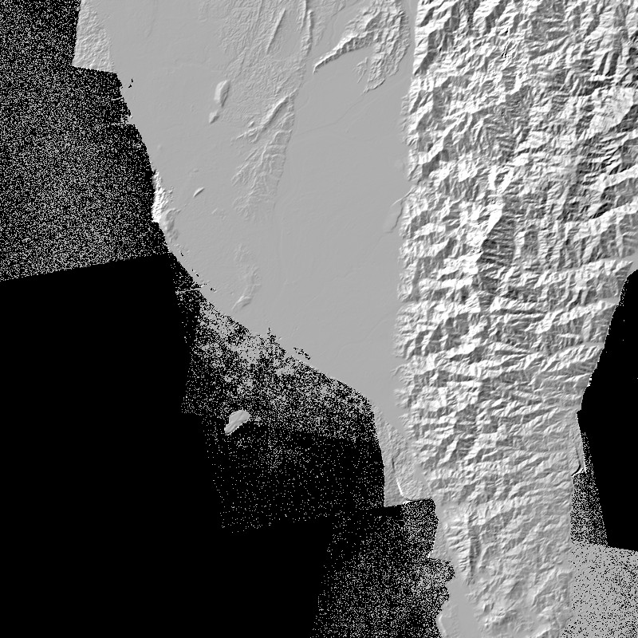
TDR Thumbnails – South Taiwan (TDR_N22E120)
UNCLASSIFIED
TREx
TREx
3118 m
-1027 m
Hillshade
graphic is UNCLASSIFIED
Shaded Relief
graphic is UNCLASSIFIED
UNCLASSIFIED

Slide 6
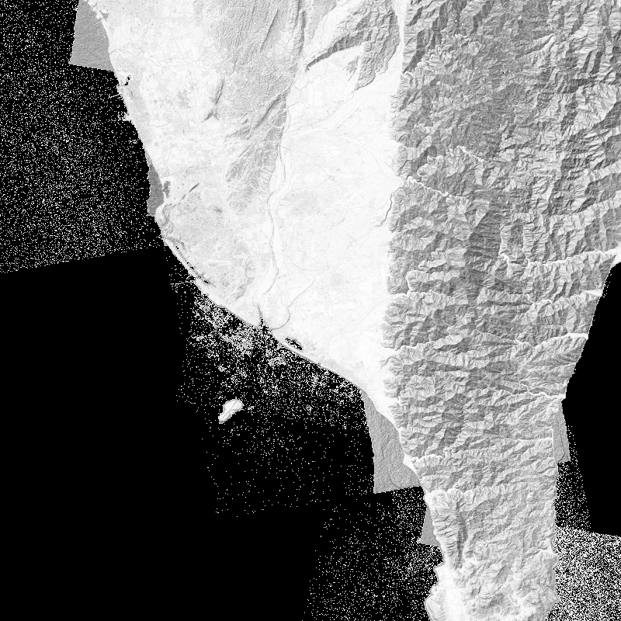
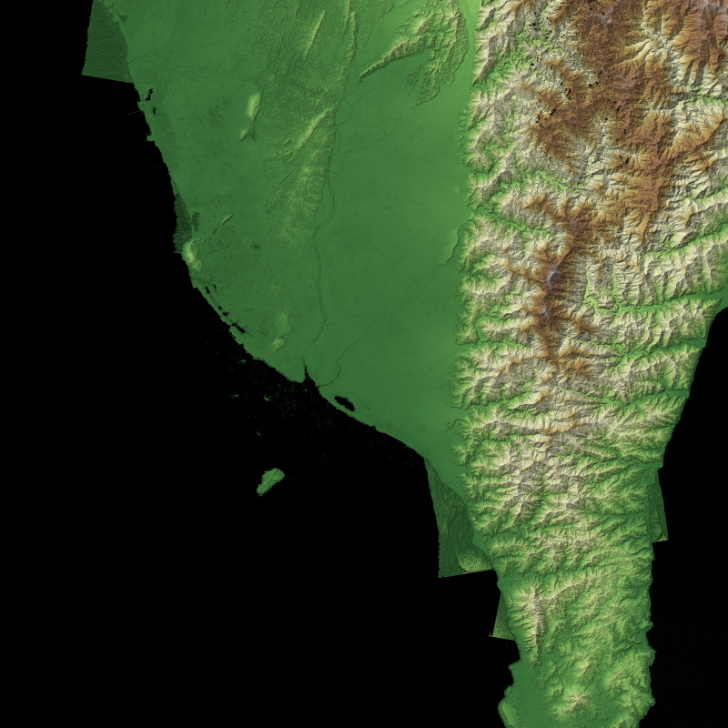

TDR Thumbnails – South Taiwan (TDR_N22E120)
UNCLASSIFIED
NGA
NGA
3118 m
0 m
Hillshade
graphic is UNCLASSIFIED
Shaded Relief
graphic is UNCLASSIFIED
UNCLASSIFIED

Slide 7
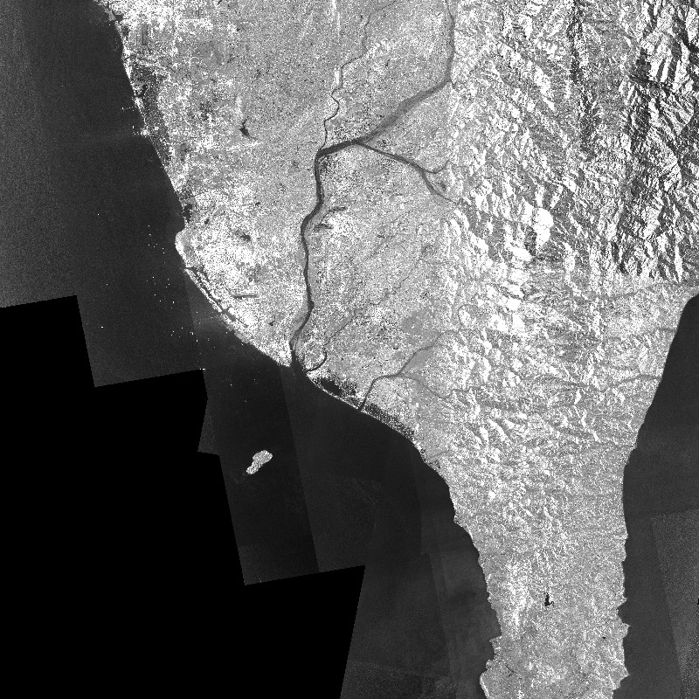
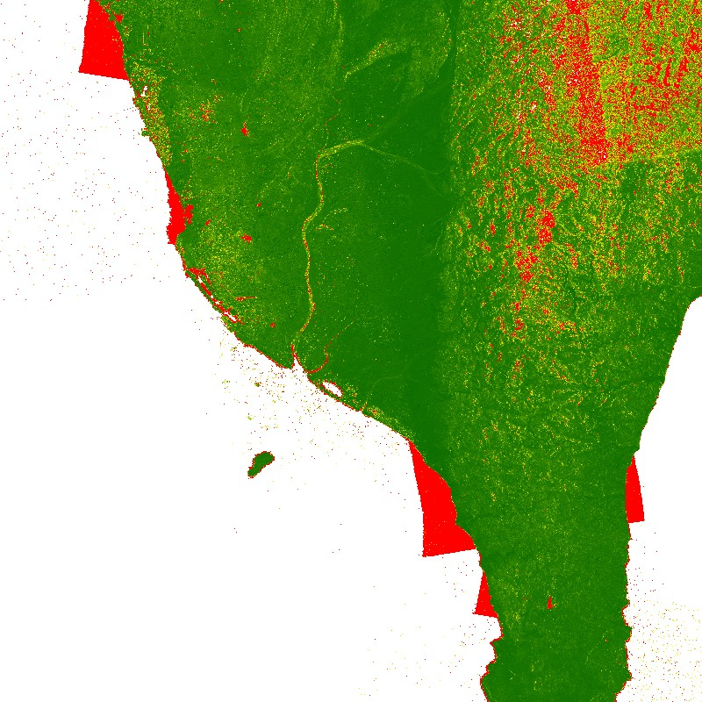

Shaded Relief Not the Whole Story… TDR Source/Error Metrics
UNCLASSIFIED
TREx
TREx
5+ m
0 m
SAR Amplitude Mosaic (AMP)
graphic is UNCLASSIFIED
Height Error Map (HEM)
graphic is UNCLASSIFIED
UNCLASSIFIED
Notes:
The auxiliary TDR thumbnails contain additional useful details, which is why 9 (!) TDR thumbnails are saved in the metadata.
For example, the over-ocean terrain anomalies over the ocean in the DSM thumbnail are flagged with the highest error value.
Prior to the existence of TDT and TDF, these auxiliary thumbnails could quickly alert users where errors are most likely, and other data sources would be preferable.

Slide 8
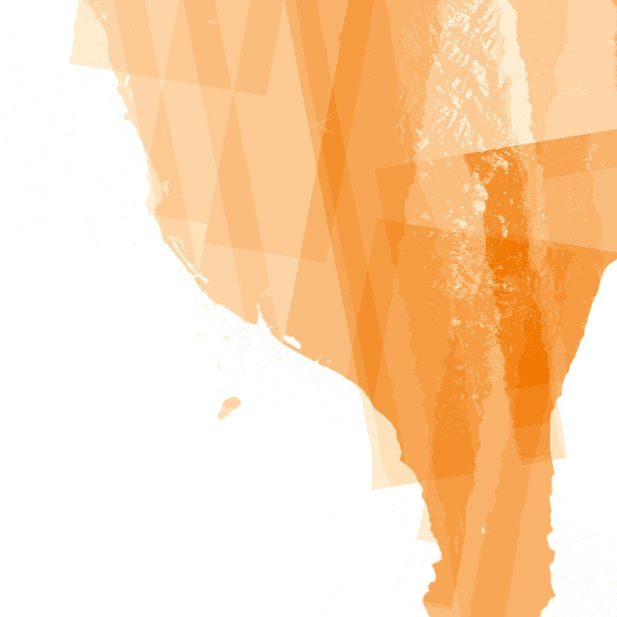
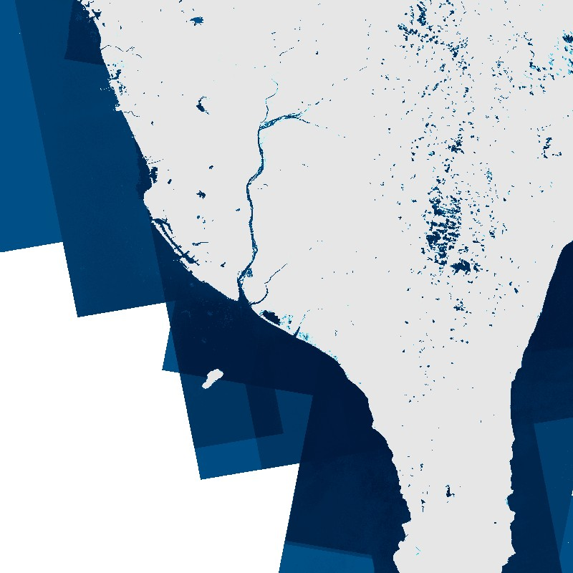


Shaded Relief Not the Whole Story… TDR Source/Error Metrics
UNCLASSIFIED
TREx
TREx
1
2
3
4
5
6
7
8
9
10
11+
Valid DEM
No WAM Processing
AMP – 15dB low
AMP – 18dB low
COH Thresh low
Coverage Map (COV)
graphic is UNCLASSIFIED
Water Indication Mask (WAM)
graphic is UNCLASSIFIED
UNCLASSIFIED

Slide 9
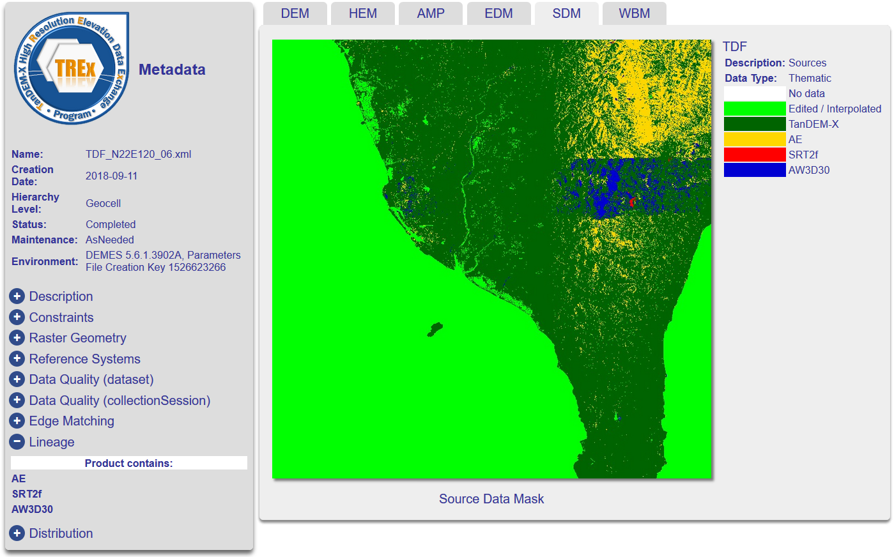
Multiple Thumbnails: TDF Template
UNCLASSIFIED
6 images: shaded relief (DEM), height error (HEM), SAR amplitude (AMP), edit model (EDM), source data mask (SDM), and water body mask (WBM)
UNCLASSIFIED
graphic is UNCLASSIFIED
Notes:
All are viewable by clicking on corresponding tab
No need to download images or view them in a separate window
Why are these supplementary thumbnails useful?
In this example, textual metadata in the “Lineage” section to the left, contains the list of fill datasets, including Active Earthscape, SRTM, and ALOS World 3D… yet the location and % coverage of the sources is not described.
A simple thumbnail and legend supplies the extra detail.
Important to note that the metadata text, thumbnail tabs, and legends all form part of an interactive HTML page.
SFNE is working to develop a similar interface for GRiD-hosted elevation data.

Slide 10
Example XML Metadata Entry
UNCLASSIFIED
A thumbnail is referenced in the XML metadata file with this template:
<mri:graphicOverview>
<mcc:MD_BrowseGraphic>
<mcc:fileName>
<gco:CharacterString>U_59N650000e5850000n_30km_2012_ArcticPS_NGA_DSM_3m_01.png</gco:CharacterString>
</mcc:fileName>
<mcc:fileDescription>
<gco:CharacterString>DSM Shaded Relief</gco:CharacterString>
</mcc:fileDescription>
<mcc:fileType>
<gco:CharacterString>PNG</gco:CharacterString>
</mcc:fileType>
<mcc:linkage>
<cit:CI_OnlineResource>
<cit:linkage>
<gco:CharacterString>./PREVIEW/U_59N650000e5850000n_30km_2012_ArcticPS_NGA_DSM_3m_01.png</gco:CharacterString>
</cit:linkage>
</cit:CI_OnlineResource>
</mcc:linkage>
</mcc:MD_BrowseGraphic>
</mri:graphicOverview>
UNCLASSIFIED

Slide 11
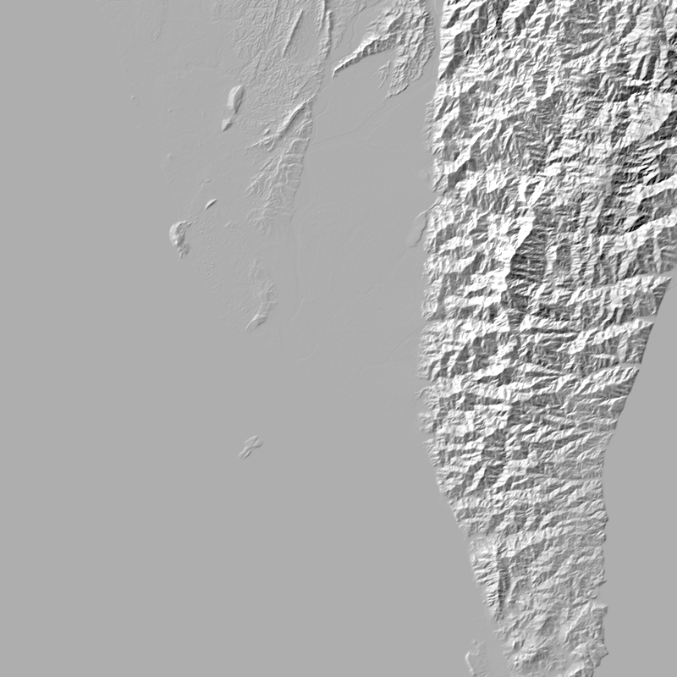
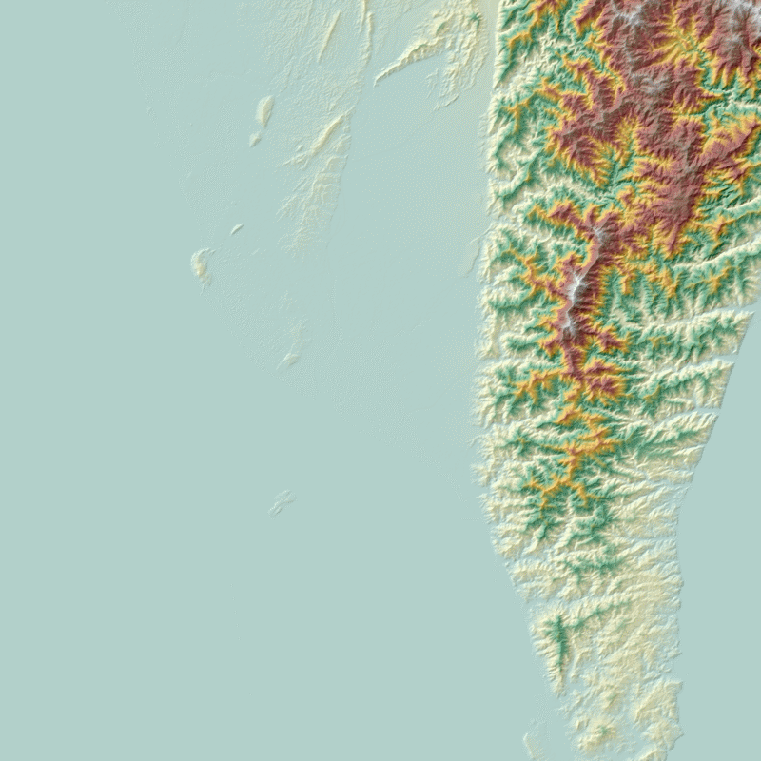
TanDEM-X Finished (TDF) – TREx Default Templates
UNCLASSIFIED
TREx
TREx
3085 m
-27 m
Hillshade
graphic is UNCLASSIFIED
Shaded Relief
graphic is UNCLASSIFIED
UNCLASSIFIED
Notes:
TREx Hillshade Problems:
traditional hillshade algorithm overexposures NW slopes while darkening SE slope textures
flat areas remain at a medium gray, which masks small textures and hides shorelines
TREx Shaded Relief Problems:
Elevation color map is not intuitive
Terrain texture is washed out in the shaded relief due to 50% opacity overlay of color relief & hillshade

Slide 12
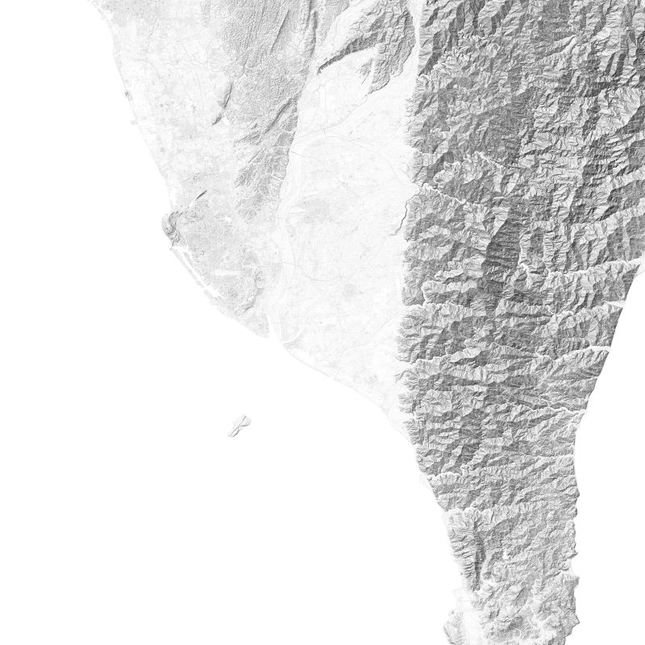
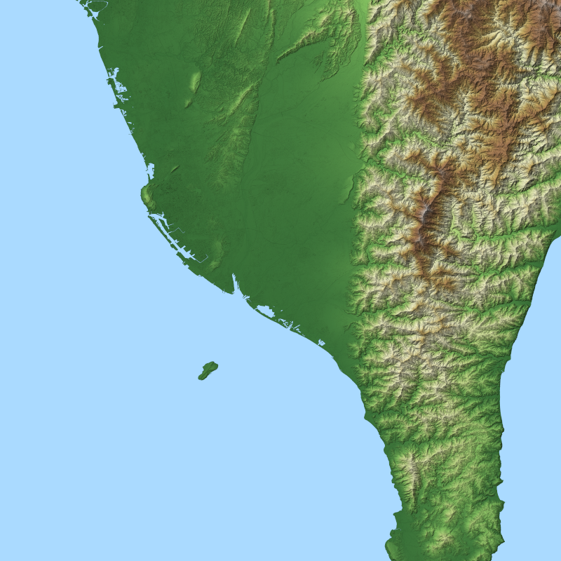
TanDEM-X Finished (TDF) – NGA Updates Hillshade, Terrain and Ocean
UNCLASSIFIED
NGA
NGA
3085 m
0 m
Hillshade
graphic is UNCLASSIFIED
Shaded Relief
graphic is UNCLASSIFIED
UNCLASSIFIED
Notes:
NGA Hillshade Improvements:
Uses GDAL’s ‘Igor’ hillshade algorithm
no washed-out NW or blackened SE slopes, preserving more detail
flat areas are completely white, preserving fine detail along edges
algorithm compensates for low-resolution data like DTED
NGA Shaded Relief Improvements:
Elevation color map is more visually intuitive (although still not accurate), from green lowlands to brown uplands to snowy peaks
Terrain texture is washed out in the shaded relief due to 50% opacity overlay of color relief & hillshade
Ocean color applied to cells with Z = 0 preserves shorelines, and could flag water artifact errors

Slide 13
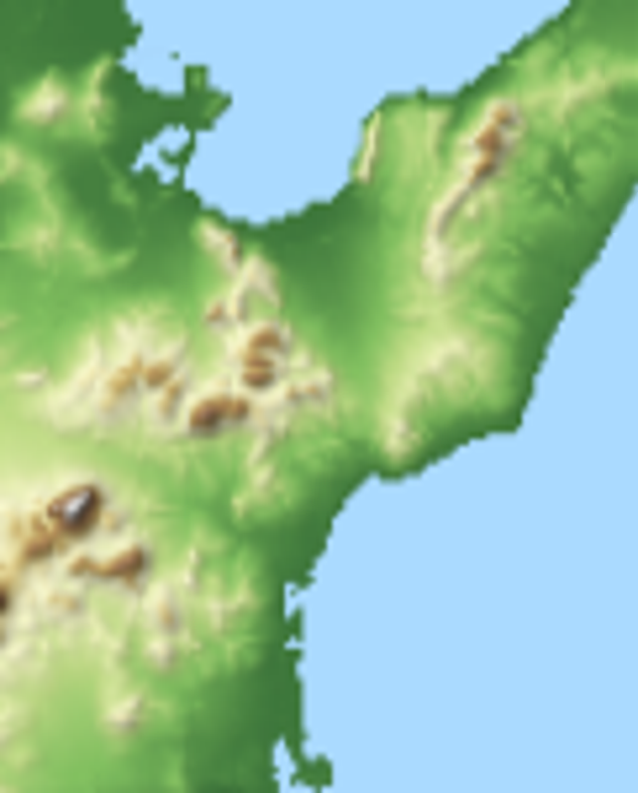
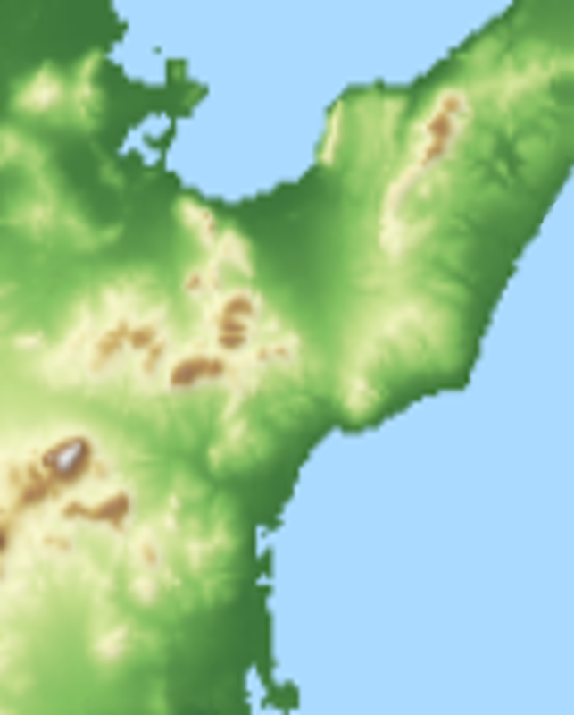
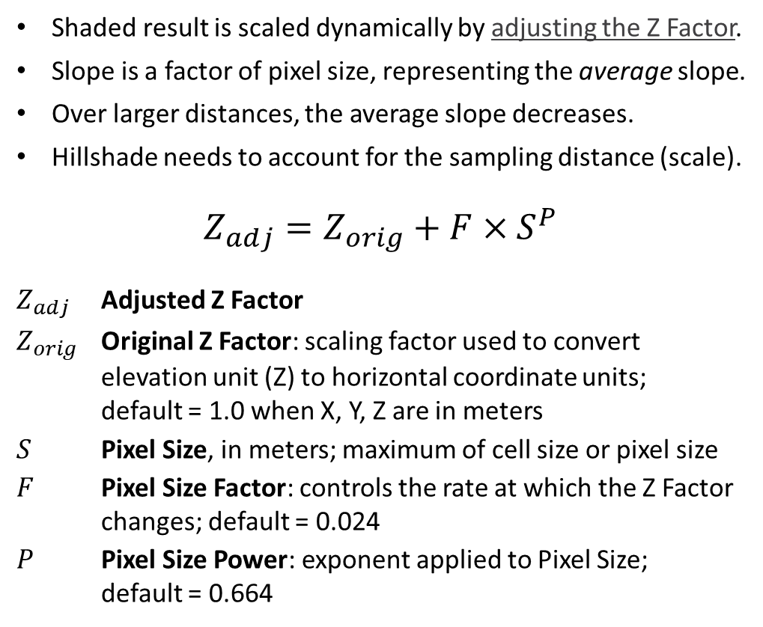
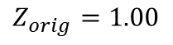
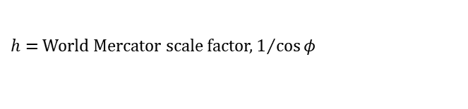
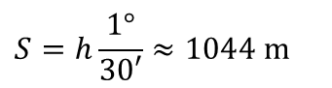
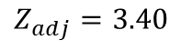
Adjusted Z Factor for Hillshade and Shaded Relief
UNCLASSIFIED
DTED0
10° E
11° E
Shaded result is scaled dynamically by adjusting the Z Factor.
Slope is a factor of pixel size, representing the average slope.
Over larger distances, the average slope decreases.
Hillshade needs to account for the sampling distance (scale).
$$Z_{adj}=Z_{orig}+F{ ×S}^{P}$$
$Z_{adj}$ Adjusted Z Factor
$Z_{orig}$ Original Z Factor: scaling factor used to convert elevation unit (Z) to horizontal coordinate units; default = 1.0 when X, Y, Z are in meters
$S$ Pixel Size, in meters; maximum of cell size or pixel size
$F$ Pixel Size Factor: controls the rate at which the Z Factor changes; default = 0.024
$P$ Pixel Size Power: exponent applied to Pixel Size; default = 0.664
37° N
Z Factor: Normal
Z Factor: Adjusted
$$Z_{adj}=3.40$$
$$Z_{orig}=1.00$$
1094 m
0 m
$$S=h\frac{1°}{30′}≈1044 m$$
graphics are UNCLASSIFIED
36° N
$h=$ World Mercator scale factor, $1/{\cos{φ}}$
UNCLASSIFIED
Notes:
Note the urban, ecological, and terrain features which are captured in the shaded slope map,
even at thumbnail resolution, which are not visible in the shaded relief.

Slide 14

Adjusted Z Factor for Hillshade and Shaded Relief
UNCLASSIFIED
DTED0
10° E
11° E
Shaded result is scaled dynamically by adjusting the Z factor.
Slope is a factor of pixel size, representing the average slope.
Over larger distances, the average slope decreases.
Hillshade needs to account for the sampling distance (scale).
$$Z_{adj}=Z_{orig}+F{ ×S}^{P}$$
$Z_{adj}$ Adjusted Z Factor
$Z_{orig}$ Original Z Factor: scaling factor used to convert elevation unit (Z) to horizontal coordinate units; default = 1.0 when X, Y, Z are in meters
$S$ Pixel Size, in meters; maximum of cell size or pixel size
$F$ Pixel Size Factor: controls the rate at which the Z Factor changes; default = 0.024
$P$ Pixel Size Power: exponent applied to Pixel Size; default = 0.664
37° N
Z Factor: Adjusted
$$Z_{adj}=3.40$$
1094 m
0 m
$$S=h\frac{1°}{30′}≈1044 m$$
graphics are UNCLASSIFIED
36° N
$h=$ World Mercator scale factor, $1/{\cos{φ}}$
UNCLASSIFIED
Notes:
Note the urban, ecological, and terrain features which are captured in the shaded slope map,
even at thumbnail resolution, which are not visible in the shaded relief.

Slide 15
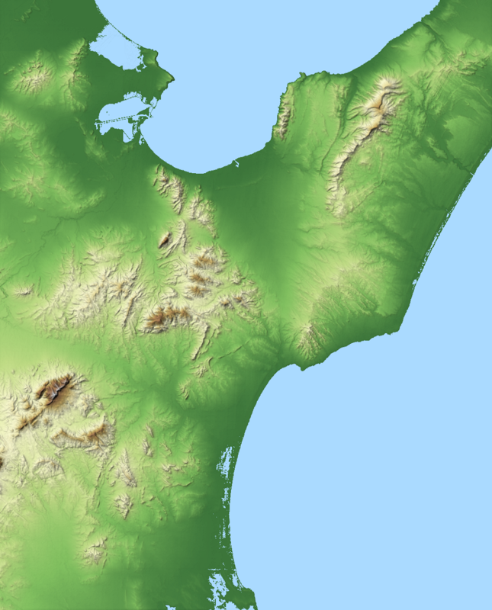
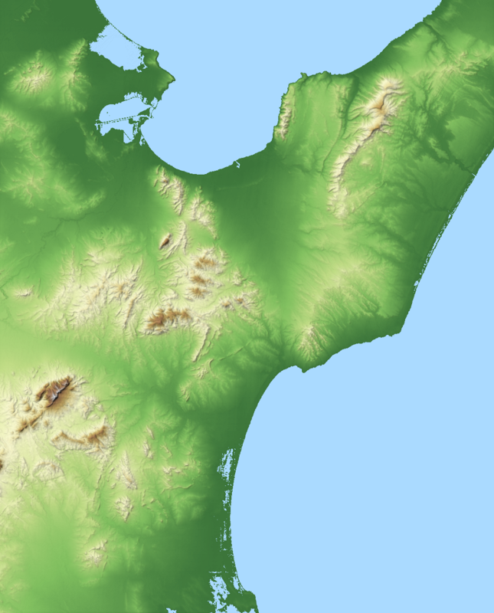
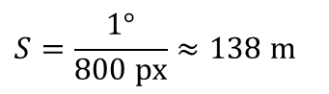
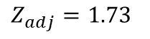
Adjusted Z Factor for Hillshade and Shaded Relief
UNCLASSIFIED
DTED1
10° E
11° E
Shaded result is scaled dynamically by adjusting the Z factor.
Slope is a factor of pixel size, representing the average slope.
Over larger distances, the average slope decreases.
Hillshade needs to account for the sampling distance (scale).
$$Z_{adj}=Z_{orig}+F{ ×S}^{P}$$
$Z_{adj}$ Adjusted Z Factor
$Z_{orig}$ Original Z Factor: scaling factor used to convert elevation unit (Z) to horizontal coordinate units; default = 1.0 when X, Y, Z are in meters
$S$ Pixel Size, in meters; maximum of cell size or pixel size
$F$ Pixel Size Factor: controls the rate at which the Z Factor changes; default = 0.024
$P$ Pixel Size Power: exponent applied to Pixel Size; default = 0.664
37° N
Z Factor: Adjusted
Z Factor: Normal
$$Z_{adj}=1.73$$
$$Z_{orig}=1.00$$
1094 m
0 m
$$S=\frac{1°}{800 px}≈138 m$$
graphics are UNCLASSIFIED
UNCLASSIFIED
Notes:
Note the urban, ecological, and terrain features which are captured in the shaded slope map,
even at thumbnail resolution, which are not visible in the shaded relief.

Slide 16
Adjusted Z Factor for Hillshade and Shaded Relief
UNCLASSIFIED
DTED1
10° E
11° E
Shaded result is scaled dynamically by adjusting the Z factor.
Slope is a factor of pixel size, representing the average slope.
Over larger distances, the average slope decreases.
Hillshade needs to account for the sampling distance (scale).
$$Z_{adj}=Z_{orig}+F{ ×S}^{P}$$
$Z_{adj}$ Adjusted Z Factor
$Z_{orig}$ Original Z Factor: scaling factor used to convert elevation unit (Z) to horizontal coordinate units; default = 1.0 when X, Y, Z are in meters
$S$ Pixel Size, in meters; maximum of cell size or pixel size
$F$ Pixel Size Factor: controls the rate at which the Z Factor changes; default = 0.024
$P$ Pixel Size Power: exponent applied to Pixel Size; default = 0.664
37° N
Z Factor: Adjusted
$$Z_{adj}=1.73$$
1094 m
0 m
$$S=\frac{1°}{800 px}≈138 m$$
graphics are UNCLASSIFIED
UNCLASSIFIED
Notes:
Note the urban, ecological, and terrain features which are captured in the shaded slope map,
even at thumbnail resolution, which are not visible in the shaded relief.

Slide 17
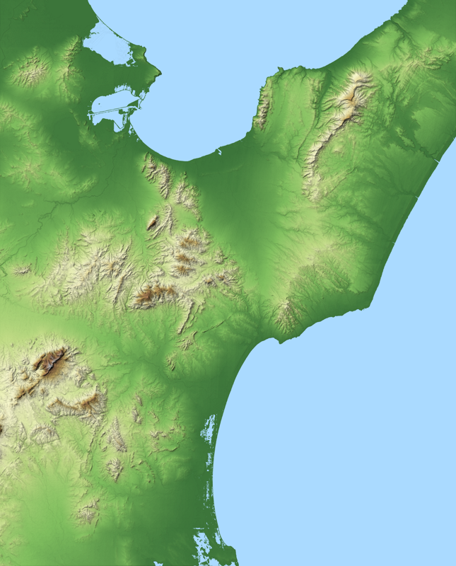
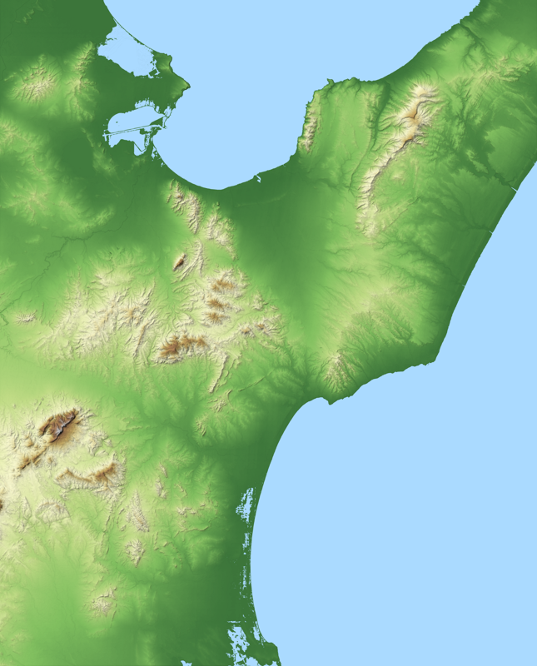
Adjusted Z Factor for Hillshade and Shaded Relief
UNCLASSIFIED
DTED2
10° E
11° E
Shaded result is scaled dynamically by adjusting the Z factor.
Slope is a factor of pixel size, representing the average slope.
Over larger distances, the average slope decreases.
Hillshade needs to account for the sampling distance (scale).
$$Z_{adj}=Z_{orig}+F{ ×S}^{P}$$
$Z_{adj}$ Adjusted Z Factor
$Z_{orig}$ Original Z Factor: scaling factor used to convert elevation unit (Z) to horizontal coordinate units; default = 1.0 when X, Y, Z are in meters
$S$ Pixel Size, in meters; maximum of cell size or pixel size
$F$ Pixel Size Factor: controls the rate at which the Z Factor changes; default = 0.024
$P$ Pixel Size Power: exponent applied to Pixel Size; default = 0.664
37° N
Z Factor: Adjusted
Z Factor: Normal
$$Z_{adj}=1.73$$
$$Z_{orig}=1.00$$
1094 m
0 m
$$S=\frac{1°}{800 px}≈138 m$$
graphics are UNCLASSIFIED
36° N
UNCLASSIFIED
Notes:
Note the urban, ecological, and terrain features which are captured in the shaded slope map,
even at thumbnail resolution, which are not visible in the shaded relief.

Slide 18
Adjusted Z Factor for Hillshade and Shaded Relief
UNCLASSIFIED
DTED2
10° E
11° E
Shaded result is scaled dynamically by adjusting the Z factor.
Slope is a factor of pixel size, representing the average slope.
Over larger distances, the average slope decreases.
Hillshade needs to account for the sampling distance (scale).
$$Z_{adj}=Z_{orig}+F{ ×S}^{P}$$
$Z_{adj}$ Adjusted Z Factor
$Z_{orig}$ Original Z Factor: scaling factor used to convert elevation unit (Z) to horizontal coordinate units; default = 1.0 when X, Y, Z are in meters
$S$ Pixel Size, in meters; maximum of cell size or pixel size
$F$ Pixel Size Factor: controls the rate at which the Z Factor changes; default = 0.024
$P$ Pixel Size Power: exponent applied to Pixel Size; default = 0.664
37° N
Z Factor: Adjusted
$$Z_{adj}=1.73$$
1094 m
0 m
$$S=\frac{1°}{800 px}≈138 m$$
graphics are UNCLASSIFIED
36° N
UNCLASSIFIED
Notes:
Note the urban, ecological, and terrain features which are captured in the shaded slope map,
even at thumbnail resolution, which are not visible in the shaded relief.

Slide 19
GRiD Derived Raster Products – Potential Thumbnail Sources
UNCLASSIFIED
SFNE is collaborating with Precise Imagery and Elevation Services (PIES) to create “derived raster products” for DEM analysis.
The full-resolution products may be downsampled to metadata thumbnails.
Shaded relief images will be viewable as GRiD Map overlays.
Other thumbnail types may be viewed in a metadata summary in a separate window, such as the TREx examples on the previous slides.
Initially, five product types will be available:
Hillshade
Shaded relief
Slope
Shaded slope
Aspect
UNCLASSIFIED

Slide 20
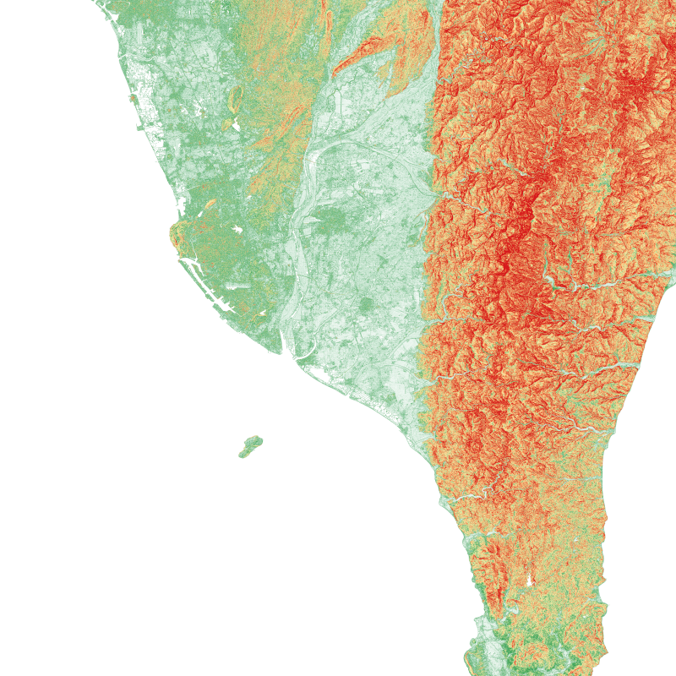
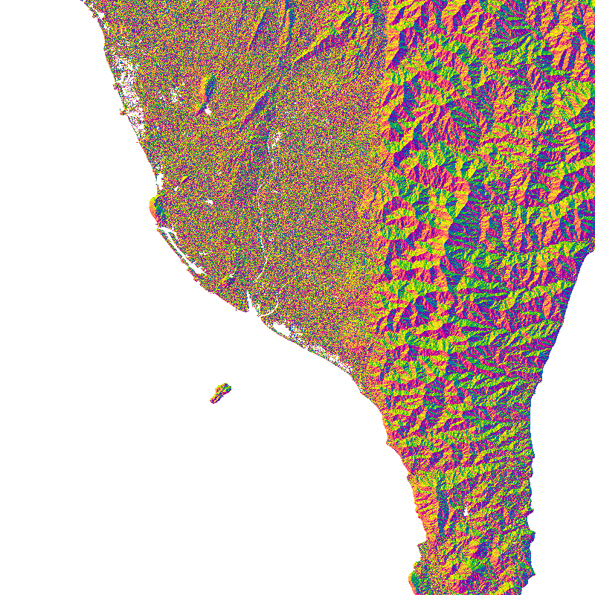
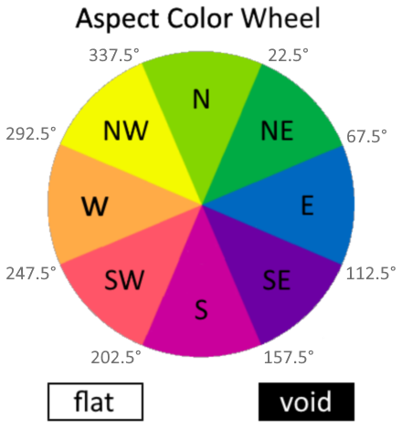

GRiD Export Product Options (In Development by PIES)
UNCLASSIFIED
40°
0°
Slope
graphic is UNCLASSIFIED
Aspect
graphic is UNCLASSIFIED
UNCLASSIFIED
Notes:
Slope and aspect maps are useful to some analysts of ecological risks or humanitarian disasters.
The goal, for this subset of users, is to cut down on the time required to generate similar products in GIS, with suboptimal color settings.
For visualization purposes, hillshade applied to color relief and slope maps are much more useful – next slide!

Slide 21
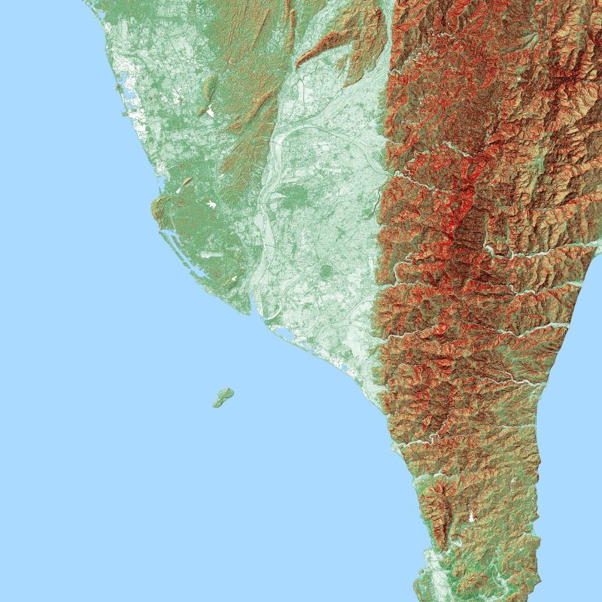
GRiD Export Product Options (In Development by PIES)
UNCLASSIFIED
40°
3085 m
0°
0 m
Shaded Slope
graphic is UNCLASSIFIED
Shaded Relief
graphic is UNCLASSIFIED
UNCLASSIFIED
Notes:
Both thumbnails capture important terrain characteristics, which are easier for the human eye to interpret when paired with a hillshade.
Note the urban, ecological, and terrain features which are captured in the shaded slope map,
even at thumbnail resolution, which are not visible in the shaded relief.

Slide 22
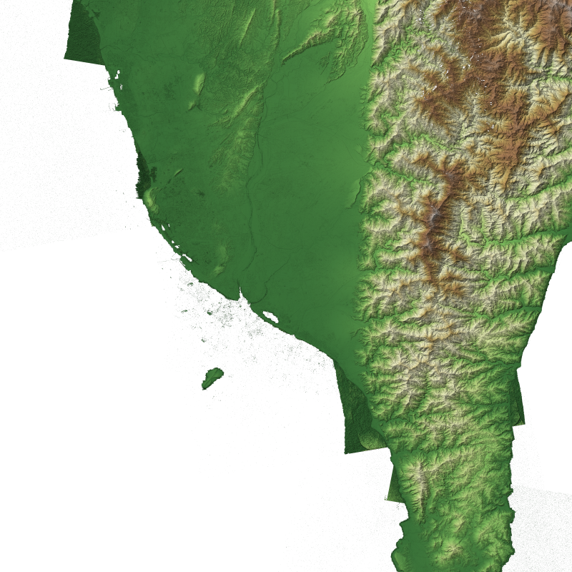
Why Use Transparency?
UNCLASSIFIED
Important for datasets with irregular borders
Allows comparison of search results in the GRiD Map because opaque void values could mask other potential fill sources
Supports alternate background colors when viewing in HTML or PDF, to highlight voids
Thumbnails must be saved in PNG format, as JPEG format does not support transparency
TDR Shaded Relief
graphic is UNCLASSIFIED
UNCLASSIFIED

Slide 23
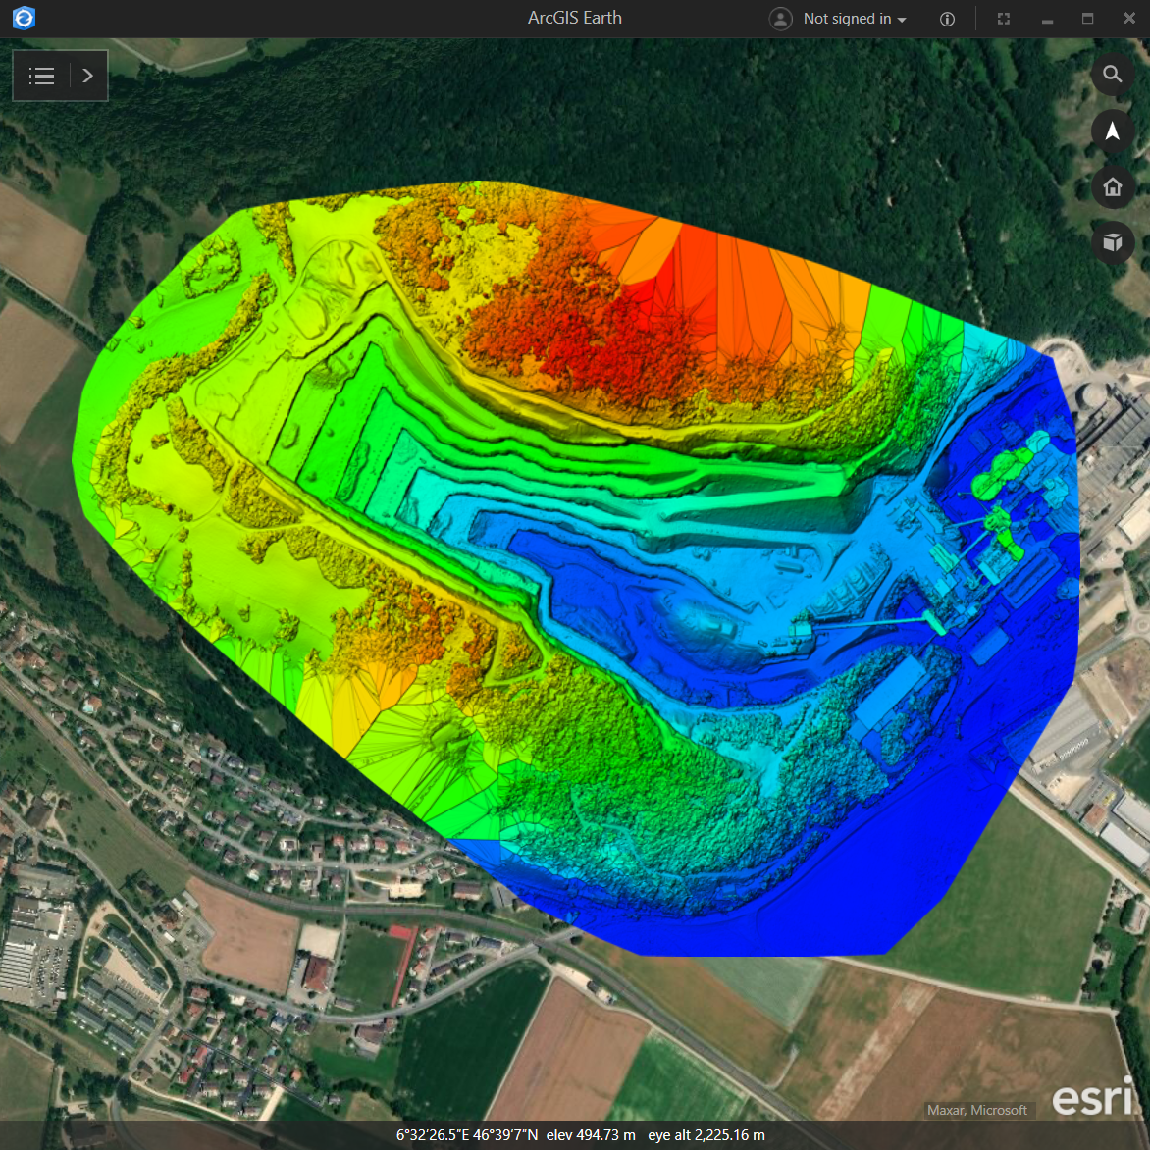
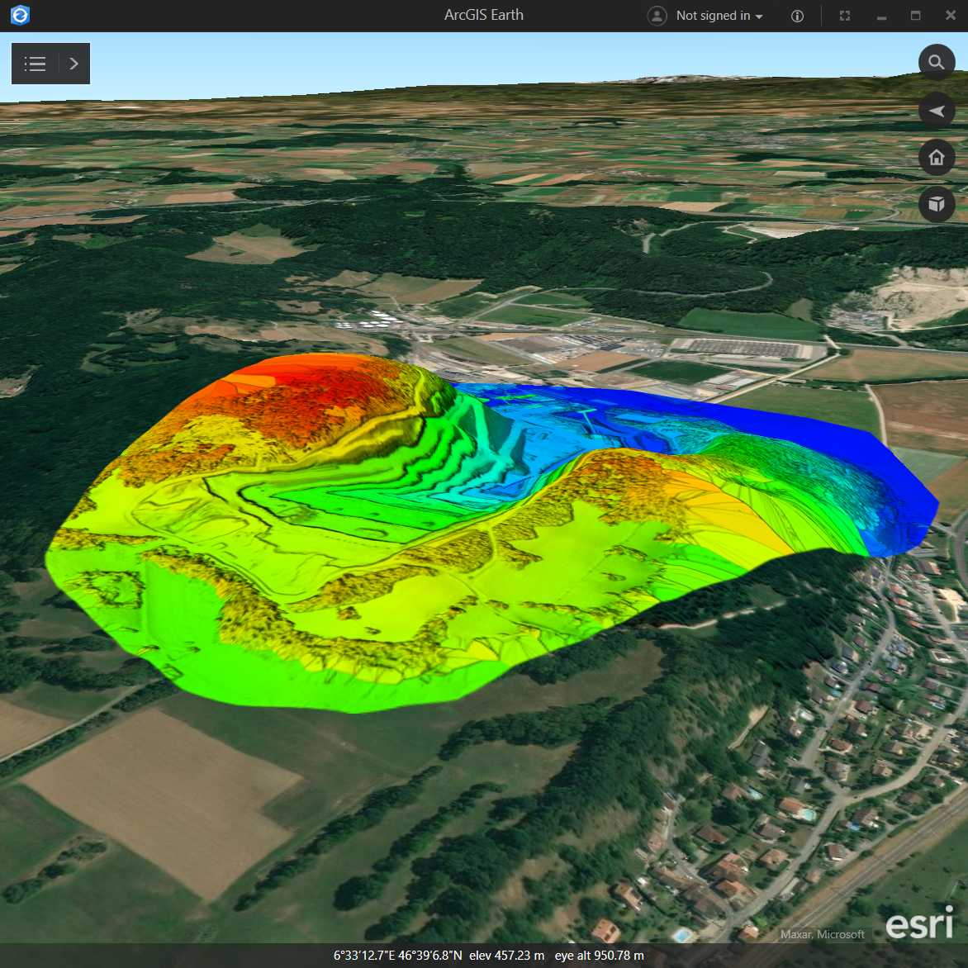
Georeferenced Thumbnails in 2D and 3D for Rapid Analysis
UNCLASSIFIED
800 px Thumbnail (1.6 m)
800 px Thumbnail (1.6 m)
Source Pix4D DSM (0.054 m)
Source Pix4D DSM (0.054 m)
Imagery © Microsoft, Maxar
graphic is UNCLASSIFIED
Imagery © Microsoft, Maxar
graphic is UNCLASSIFIED
UNCLASSIFIED
Notes:
Thumbnails can be stored with the source georeferenced extent.
The 450 MB, 5.4 cm pixel UAS-derived DSM is not needed for preliminary analysis or comparison to other potential source datasets in GRiD.
It takes time for analysts to process such large DEMs in GIS software, and many lack the necessary hardware and software.
while the thumbnail can be viewed in geographic context in GRiD Map or 3D viewers.
Even downsampled to 800 px, the thumbnail resolution is 1.64 m.
Next, we will overlay a global Source terrain, TERRAFORM, at full resolution.

Slide 24
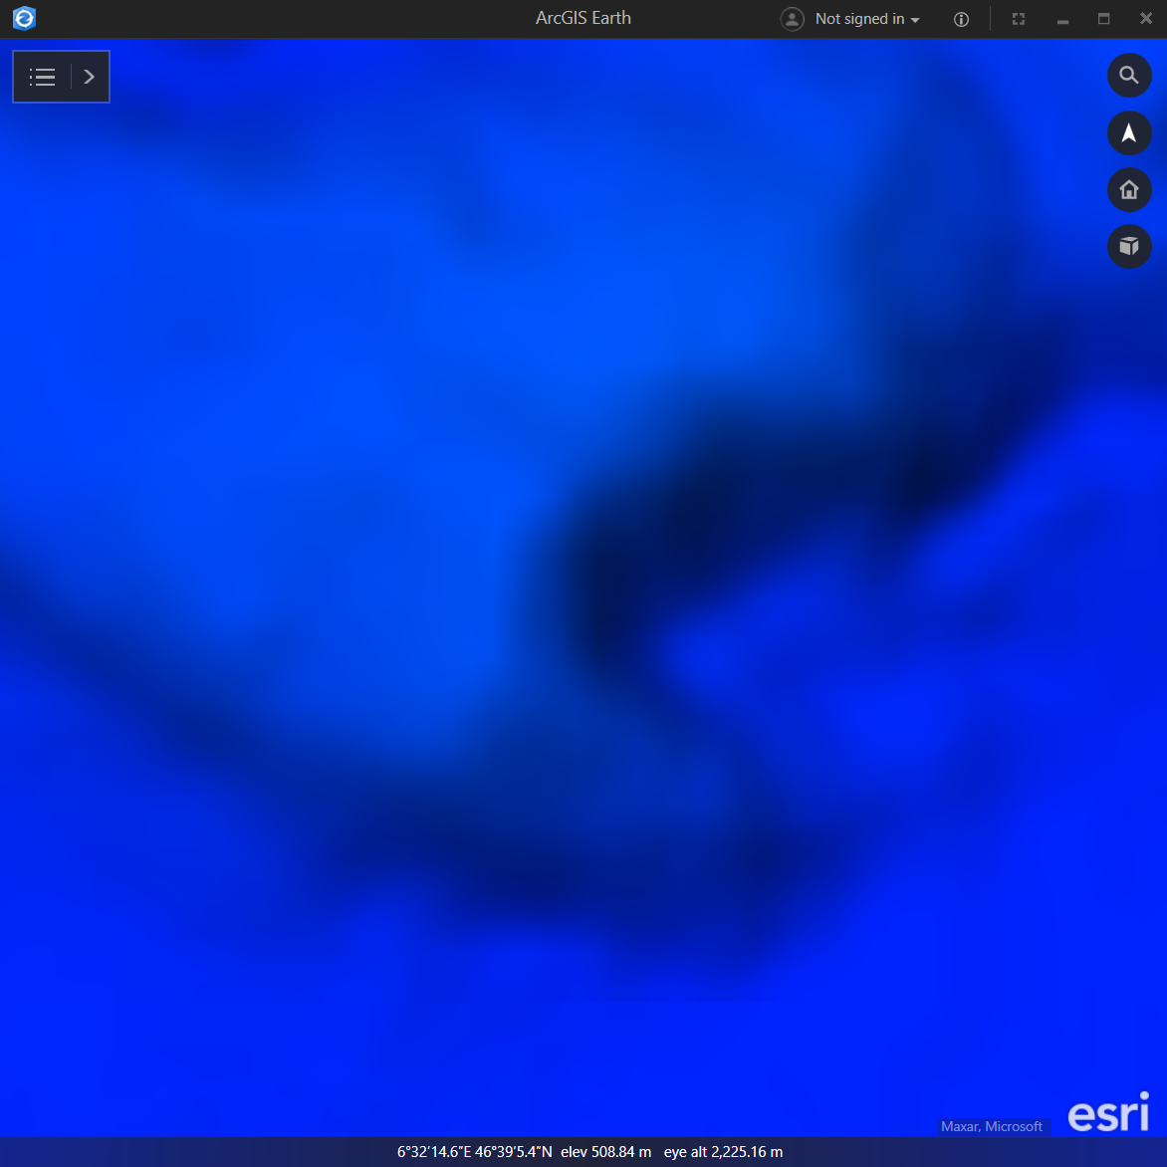
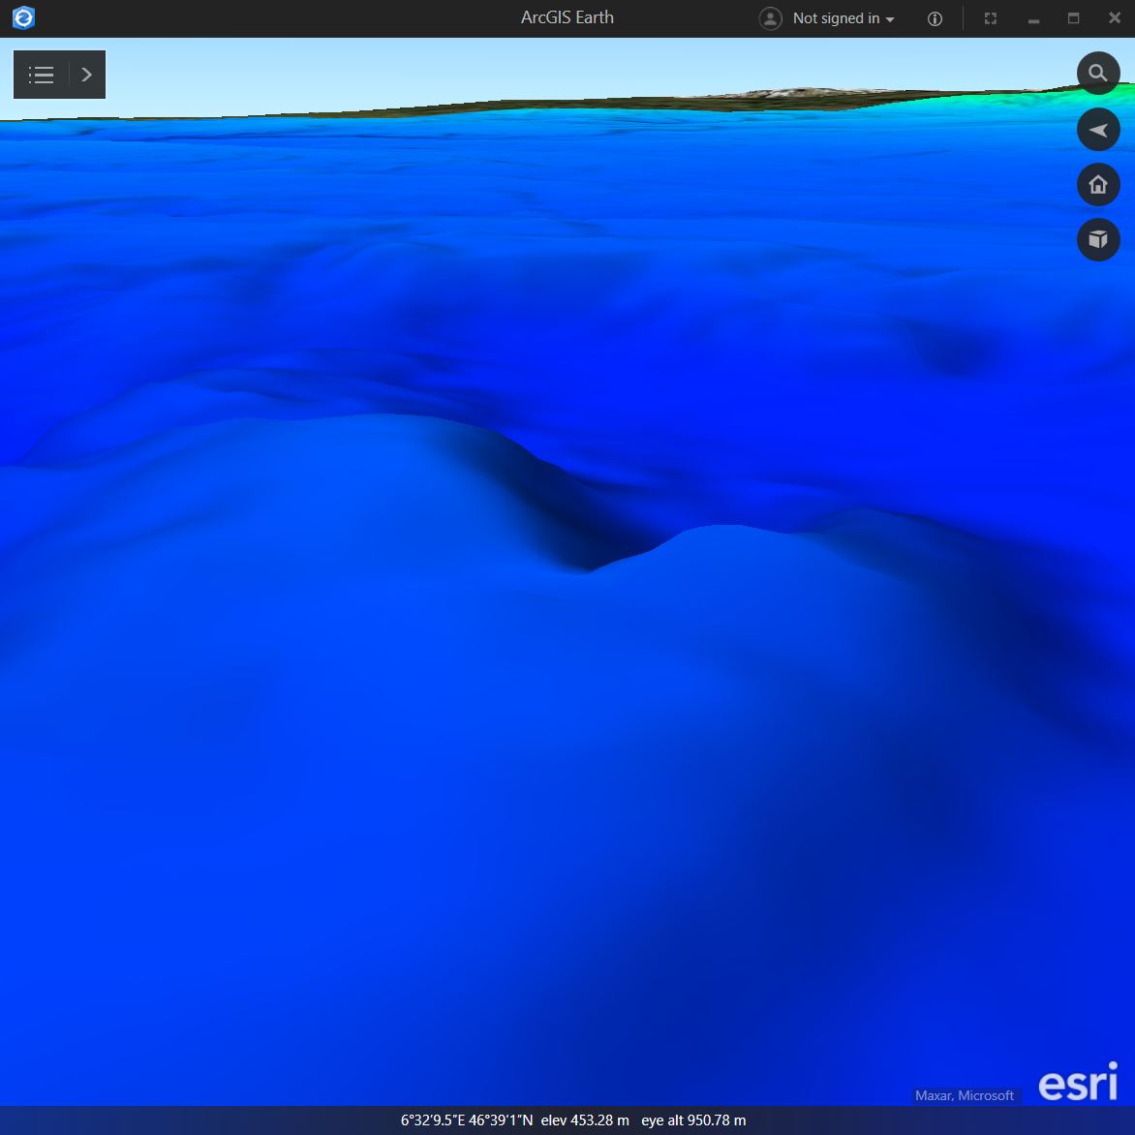
Georeferenced Thumbnails in 2D and 3D for Rapid Analysis
UNCLASSIFIED
TERRAFORM (30 m)
TERRAFORM (30 m)
Imagery © Microsoft, Maxar
graphic is UNCLASSIFIED
Imagery © Microsoft, Maxar
graphic is UNCLASSIFIED
UNCLASSIFIED
Notes:
The full-resolution TERRAFORM DEM, which is a standard Source elevation product, contains far less detail than even the thumbnail representation of the UAS-derived DSM.

Slide 25
Point Cloud Thumbnails
UNCLASSIFIED
Point cloud thumbnails typically only contain height colors, intensity, or a combination of the two.
Point clouds with R, G, and B attributes may also create orthophotos.
Because points are not joined in a mesh, they can’t create shadows or slopes, which are helpful for visual interpretation.
2D thumbnails may be more intuitive and better represent the data if points are classified and gridded to DSM/DTM first.
The following slides show 5 standard (point only) and 5 extended (surface-augmented) thumbnails for a LiDAR point cloud in St. Louis.
UNCLASSIFIED

Slide 26
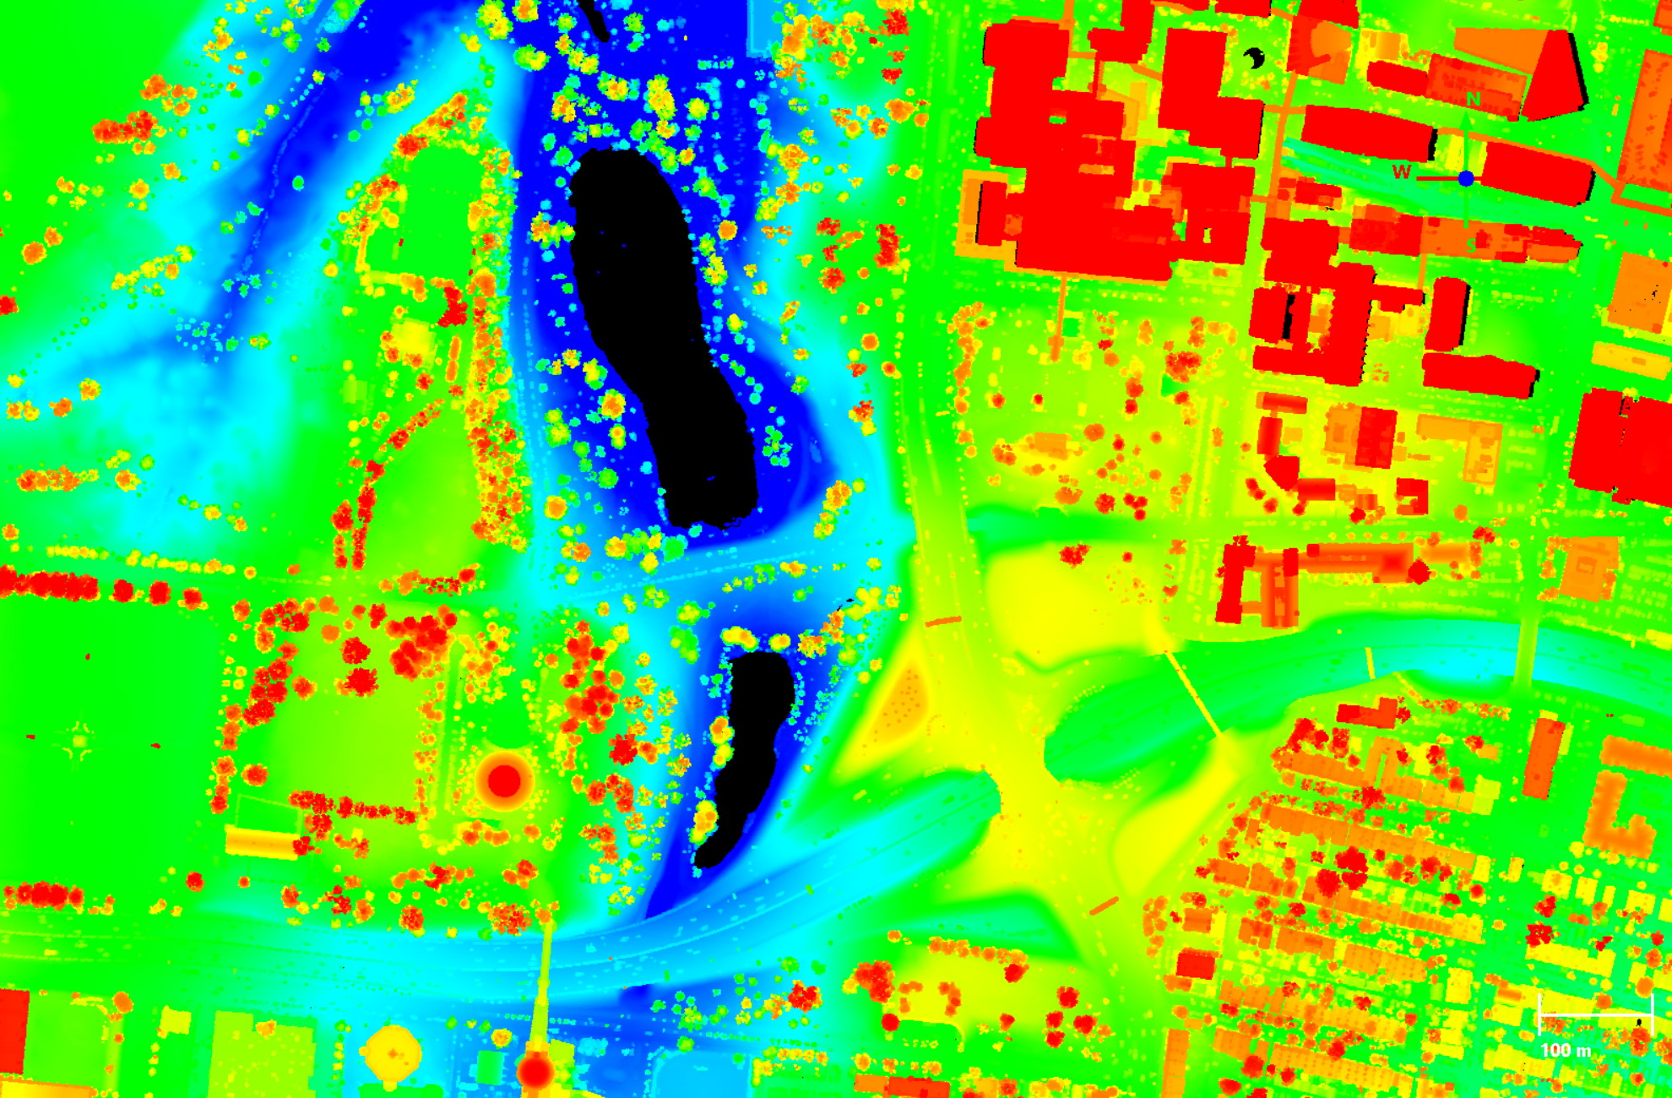

Standard PC: Point Height Colors
UNCLASSIFIED
234 m
140 m
Source: USGS LiDAR, St. Louis, February 2017
graphic is UNCLASSIFIED
UNCLASSIFIED

Slide 27
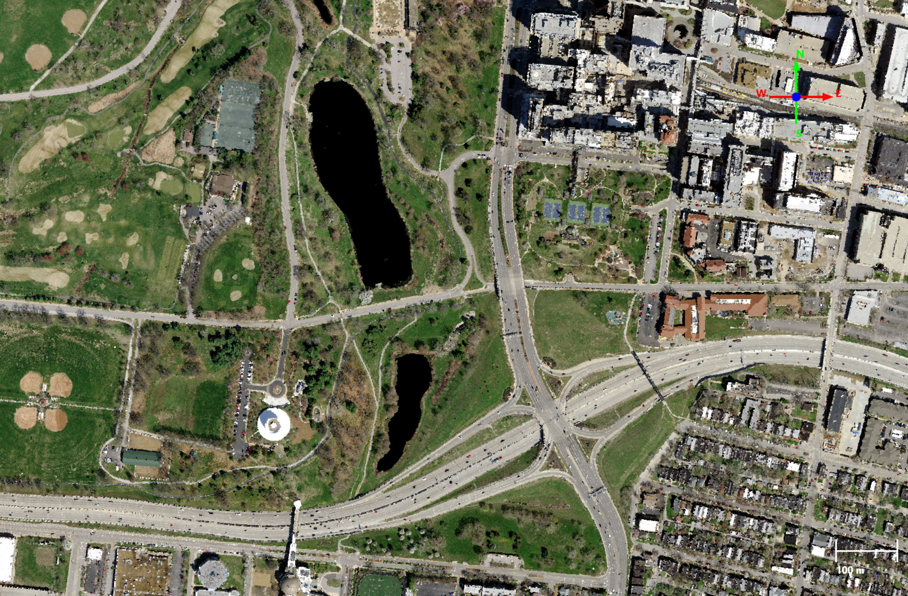
Standard PC: Point RGB Attributes (Orthophoto)
UNCLASSIFIED
Source: USGS LiDAR, St. Louis, February 2017
graphic is UNCLASSIFIED
UNCLASSIFIED

Slide 28
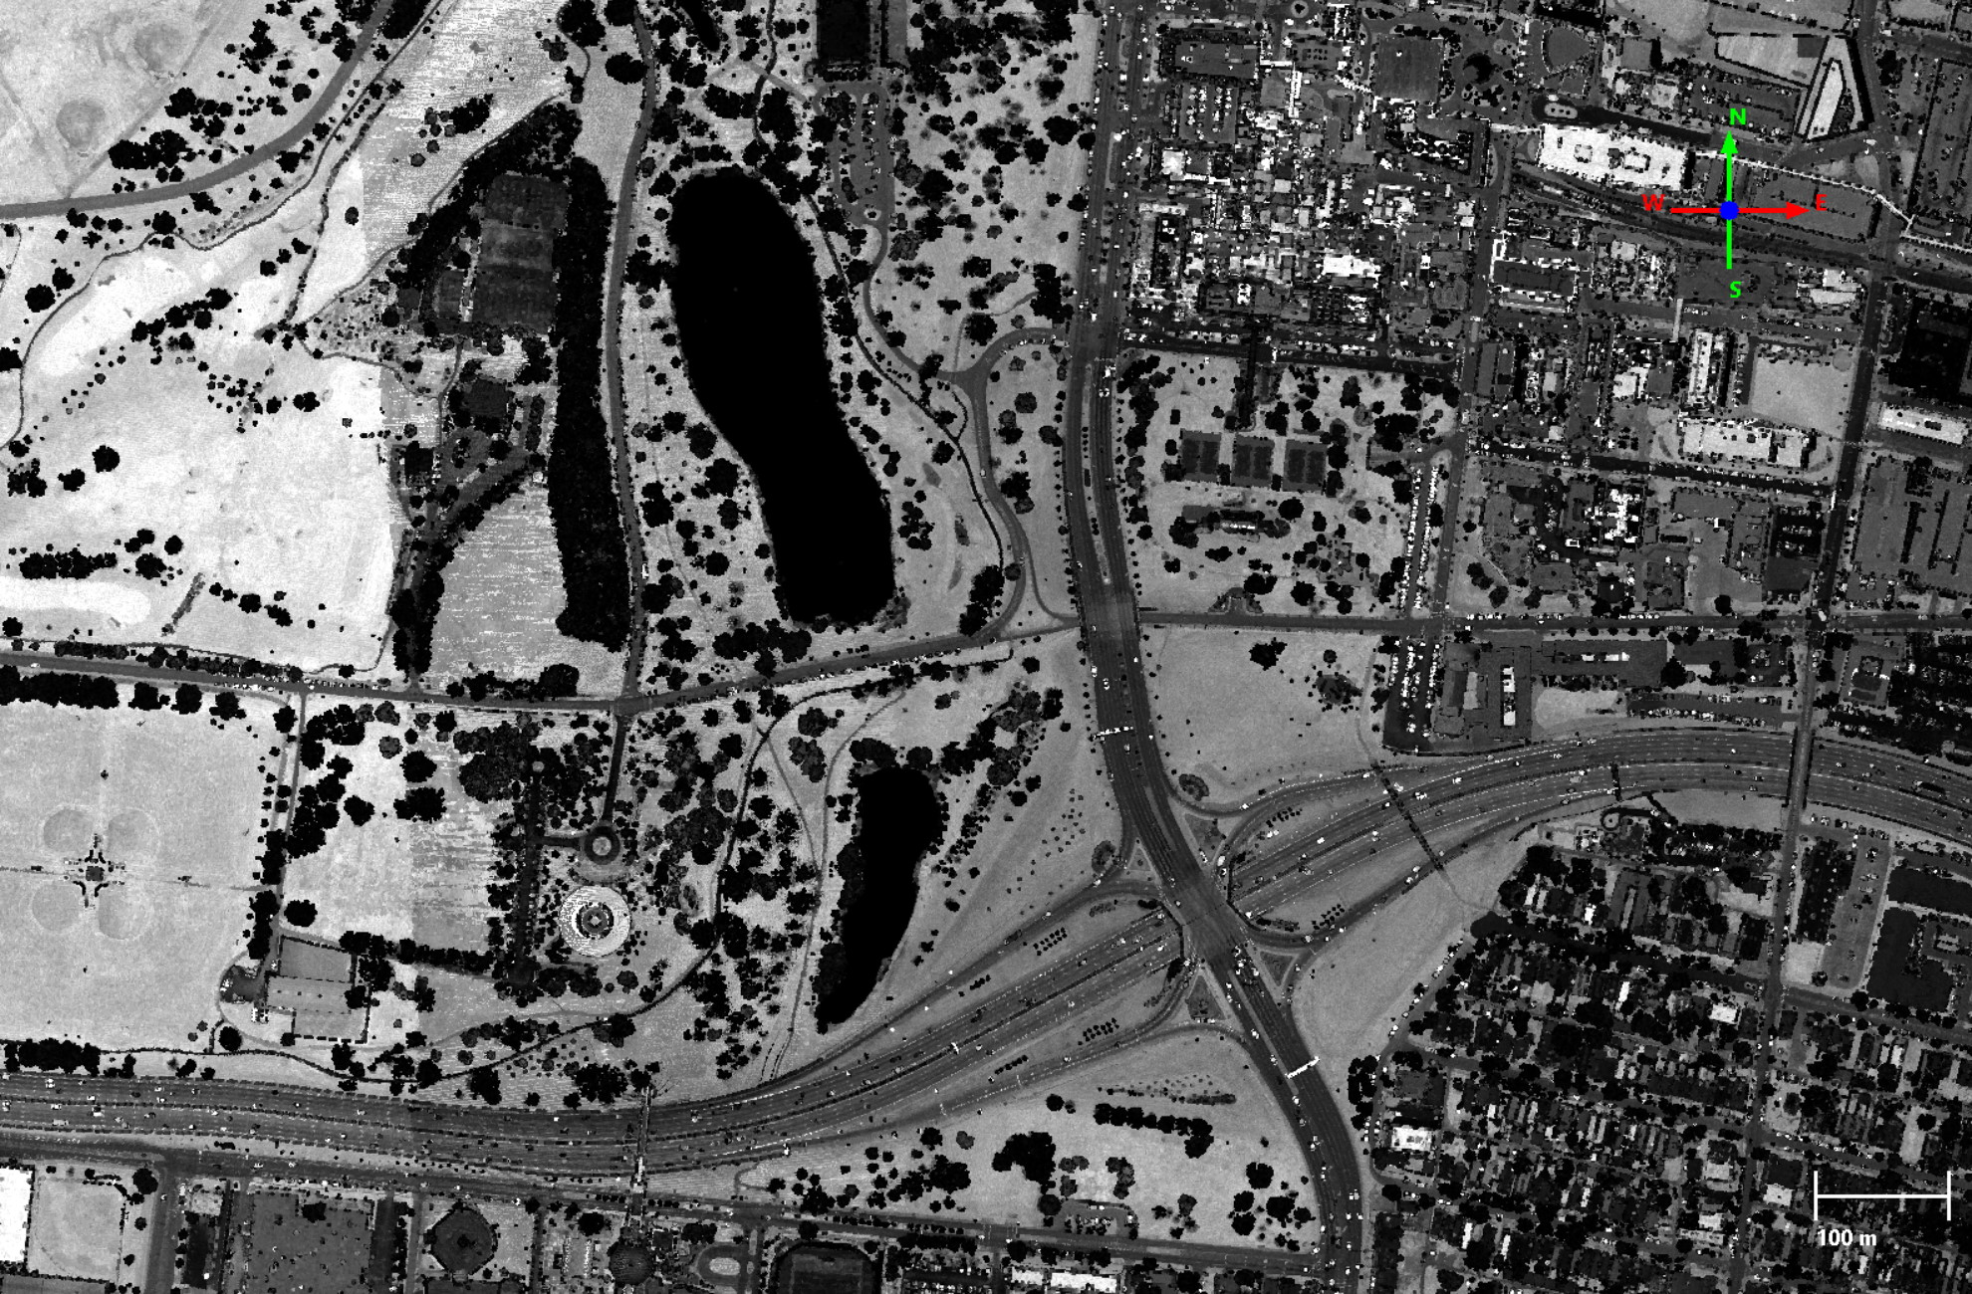
Standard PC: Point Intensity
UNCLASSIFIED
Source: USGS LiDAR, St. Louis, February 2017
graphic is UNCLASSIFIED
UNCLASSIFIED

Slide 29
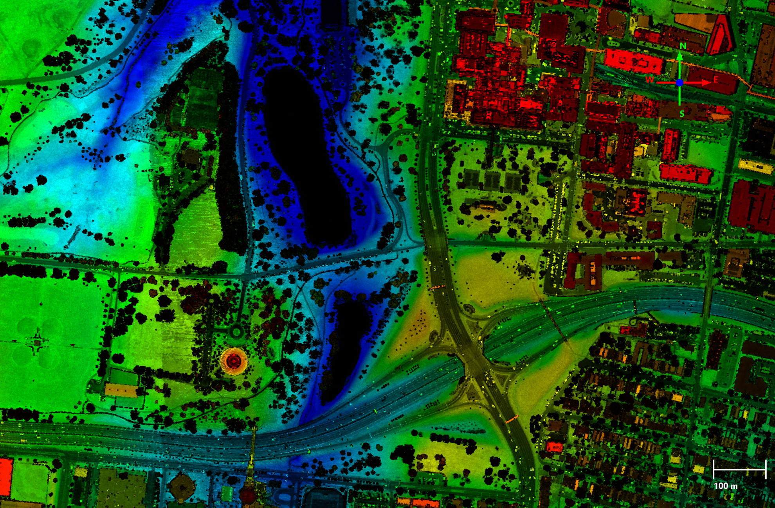
Standard PC: Height Color & Intensity
UNCLASSIFIED
234 m
140 m
Source: USGS LiDAR, St. Louis, February 2017
graphic is UNCLASSIFIED
UNCLASSIFIED

Slide 30
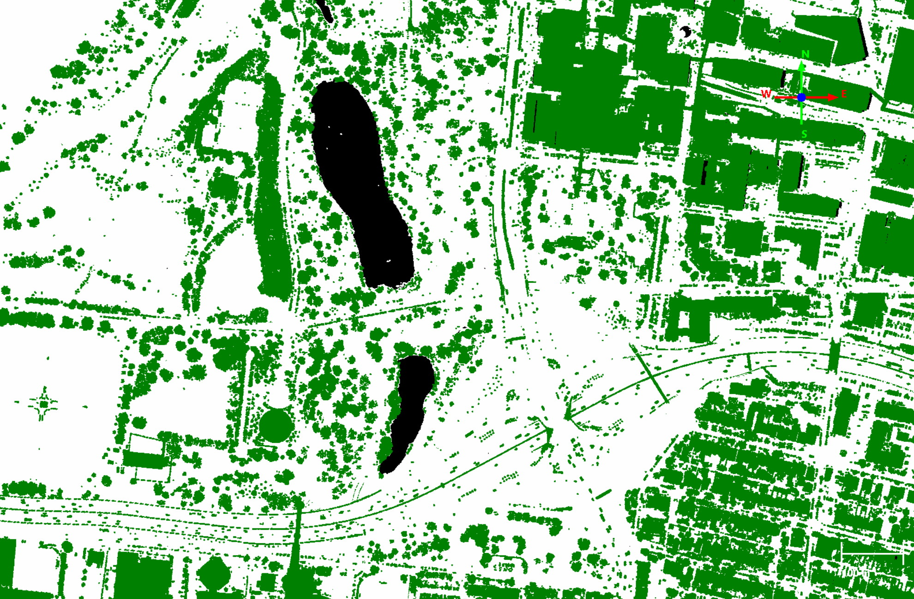
Standard PC: Classification
UNCLASSIFIED
ground
non-ground
void
Source: USGS LiDAR, St. Louis, February 2017
graphic is UNCLASSIFIED
UNCLASSIFIED

Slide 31
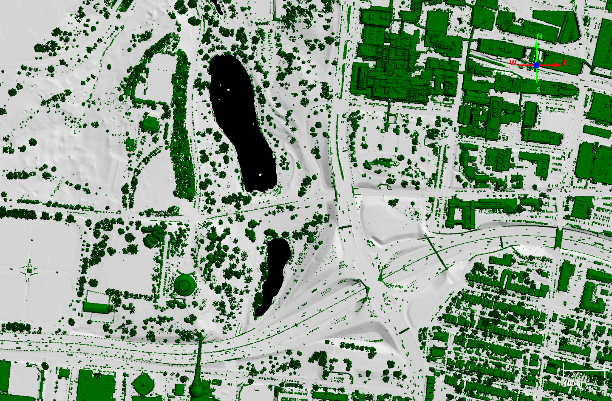
Extended PC: Shaded Classification
UNCLASSIFIED
ground
non-ground
void
Source: USGS LiDAR, St. Louis, February 2017
graphic is UNCLASSIFIED
UNCLASSIFIED

Slide 32
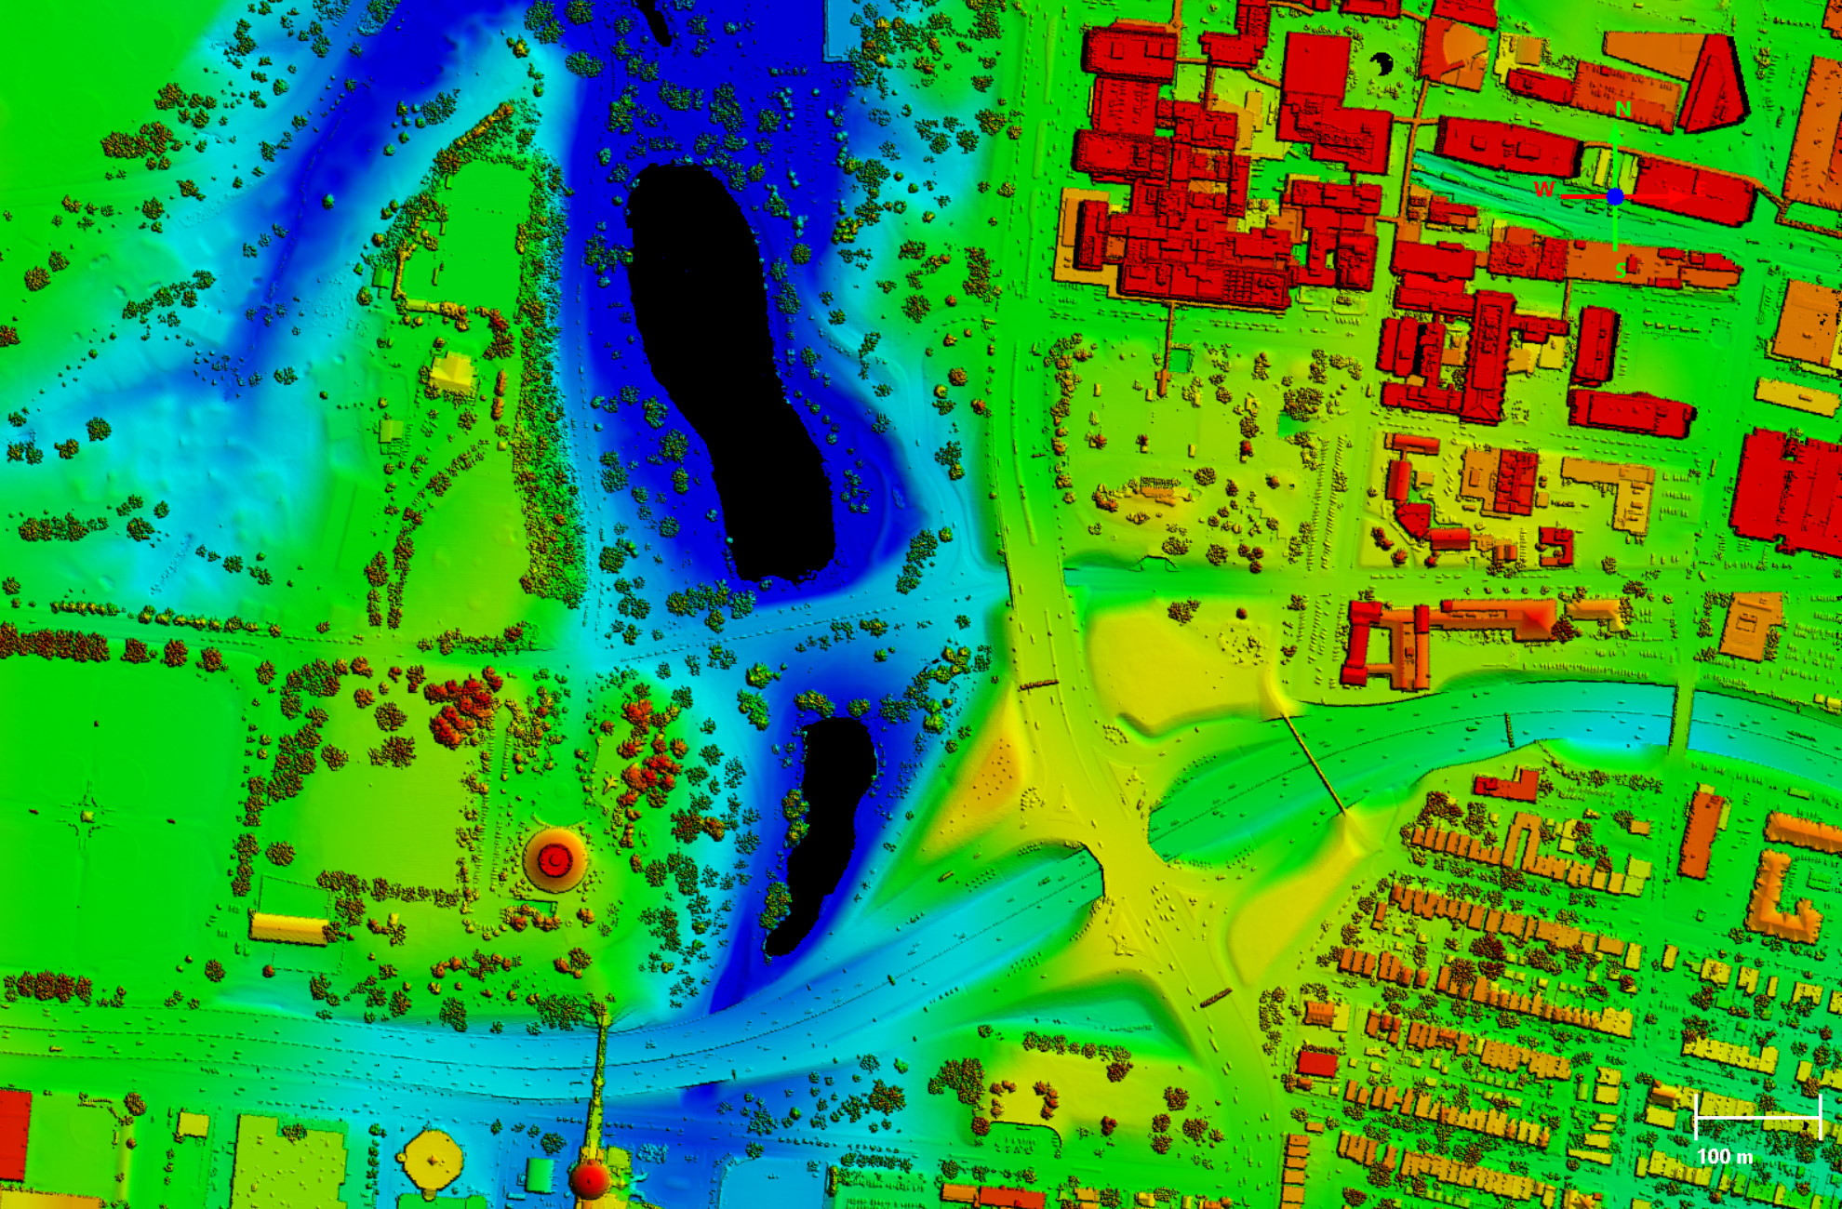
Extended PC: Shaded Relief
UNCLASSIFIED
234 m
140 m
Source: USGS LiDAR, St. Louis, February 2017
graphic is UNCLASSIFIED
UNCLASSIFIED

Slide 33
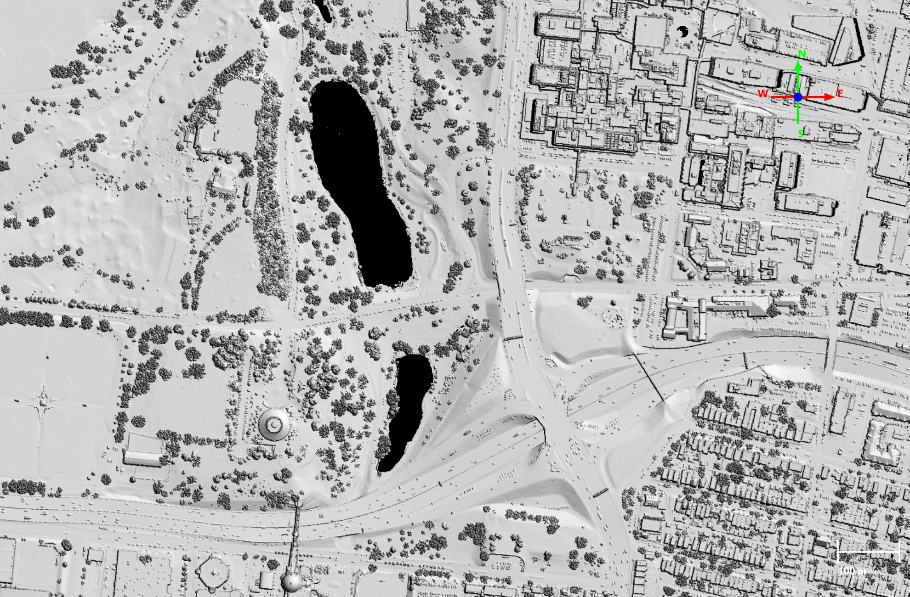
Extended PC: DSM Hillshade
UNCLASSIFIED
Source: USGS LiDAR, St. Louis, February 2017
graphic is UNCLASSIFIED
UNCLASSIFIED

Slide 34
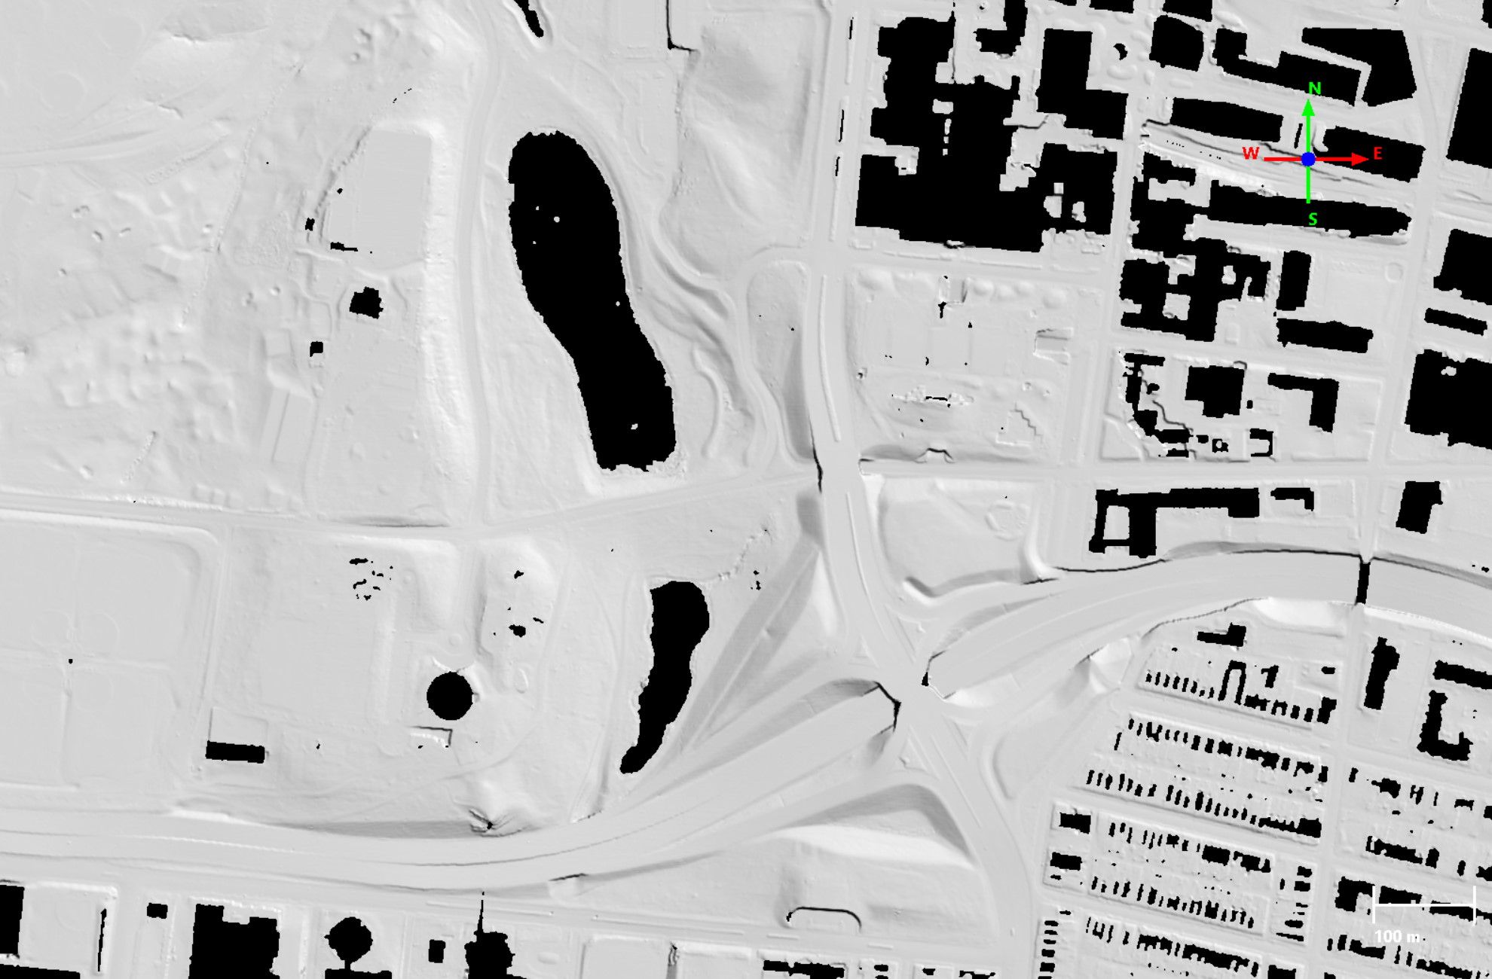
Extended PC: DTM Hillshade
UNCLASSIFIED
Source: USGS LiDAR, St. Louis, February 2017
graphic is UNCLASSIFIED
UNCLASSIFIED

Slide 35
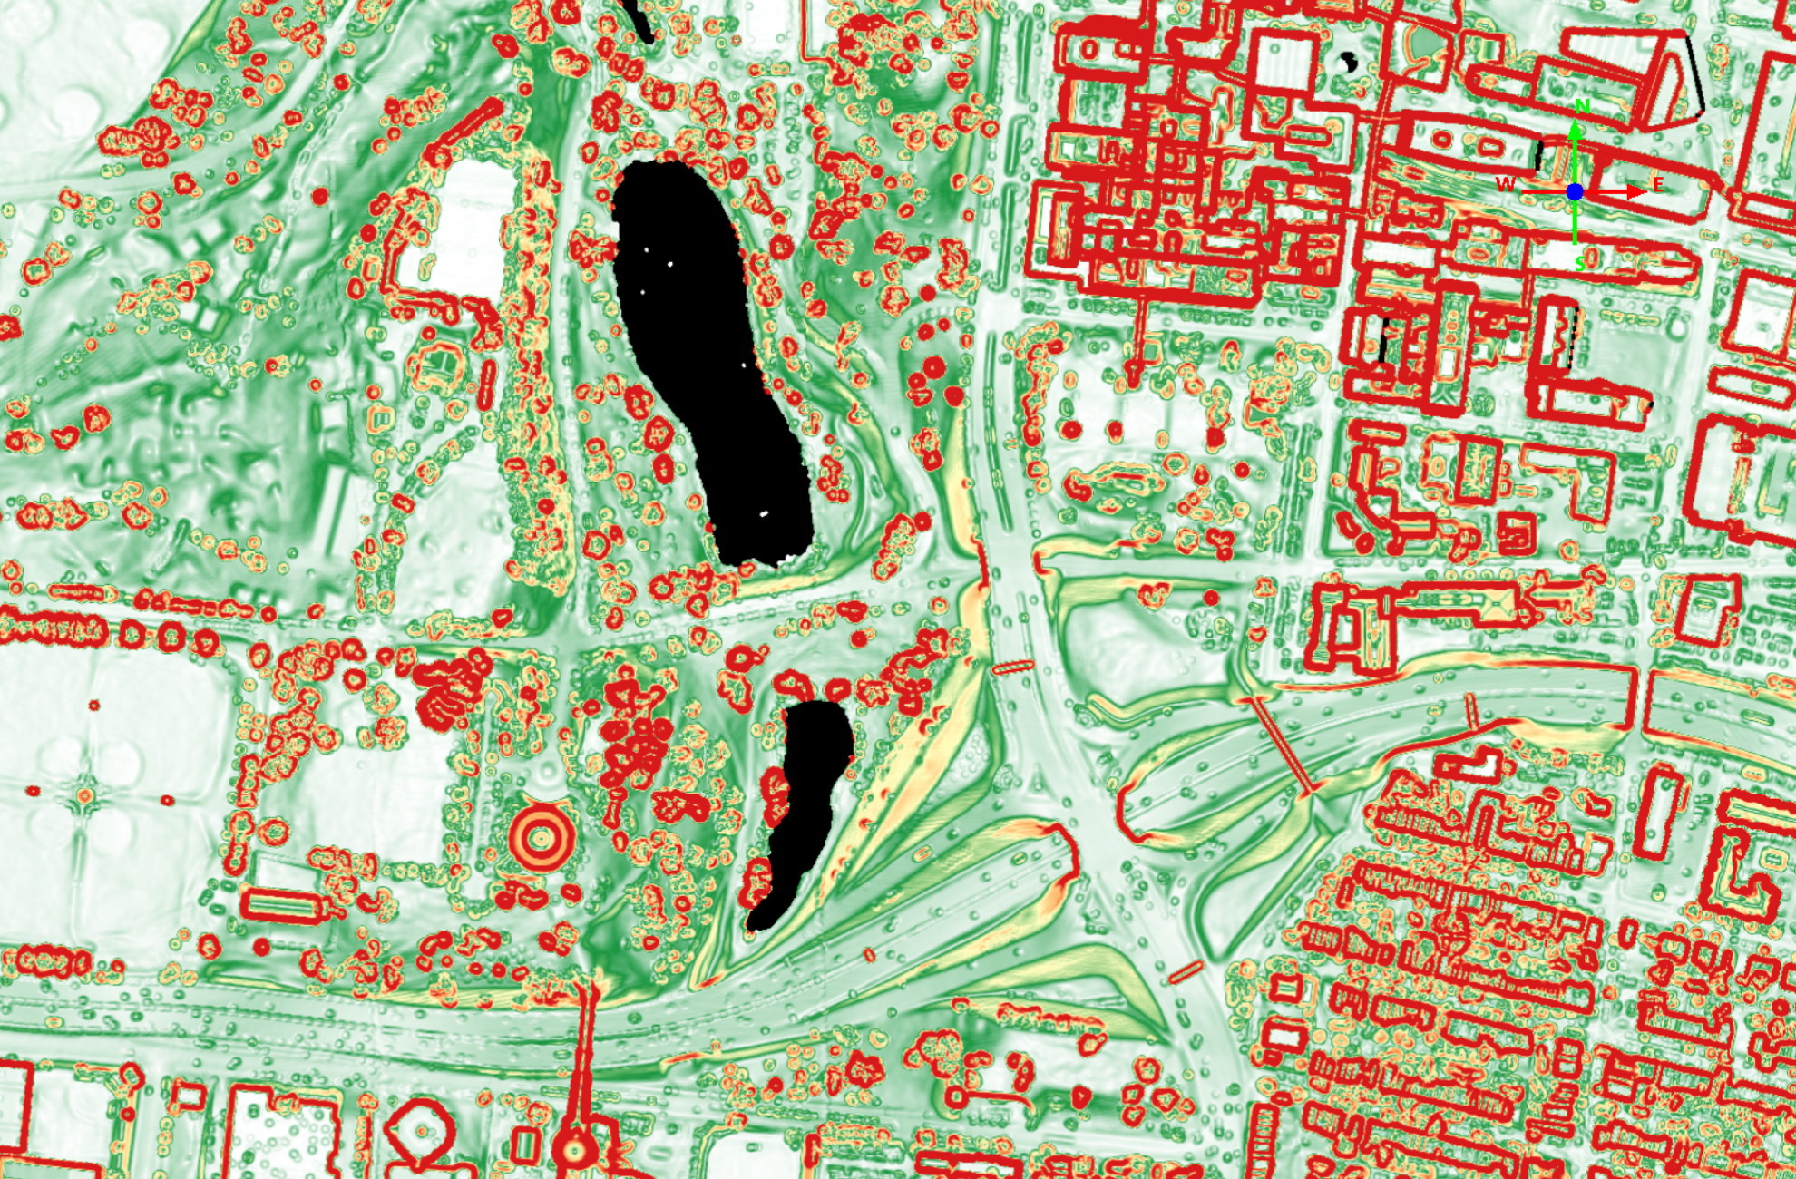
Extended PC: Slope
UNCLASSIFIED
40°
0°
Source: USGS LiDAR, St. Louis, February 2017
graphic is UNCLASSIFIED
UNCLASSIFIED

Slide 36
Coming Soon: LE90 and CE90 from LAS and BPF Files
UNCLASSIFIED
The Generic Point Cloud Model (GPM) stores error ellipsoids for EO-derived point clouds.
GPM error data cannot be viewed in commercial software.
A draft QT Modeler plugin utilizes GPM and Per Point Error (PPE) to interpolate LE90/CE90 as a point level attribute.
The error attributes can then be interpolated into GeoTIFFs.
RGB thumbnails of the error grids will alert analysts of data reliability and highlight areas where new data is needed.
UNCLASSIFIED

Slide 37
Conclusion
UNCLASSIFIED
Metadata text can be long but not spatial; a picture is truly is worth 1,000 words.
Thumbnails allow analysts to check quality metrics and identify error locations.
SFNE has optimized thumbnail styling, already in use for DGED data.
Multiple thumbnails can be viewed in a web browser using the NSG Elevation Metadata Implementation Specification (NEMIS) XML template.
SFNE offers the following recommendations for thumbnail generation:
Don’t limit them to shaded relief
Use moderate resolution; 800 pixels on longest edge is ideal
Format as PNG files to support transparency, as needed
Apply ‘Adjusted Z Factor’ to darken shadows
Create extended point cloud thumbnails interpolating to DSM or DTM
UNCLASSIFIED

Slide 38
UNCLASSIFIED
UNCLASSIFIED

Slide 39
Abstract
UNCLASSIFIED
(U) Metadata is important for cataloguing the exploding quantity of 3D, high-resolution elevation data in the cloud, supporting data searches, and relaying critical accuracy information for analysis. However, metadata files are often very complex, rendering them difficult to apply for unique mission sets, and they can also be tedious to generate. As a result, metadata is often overlooked by data producers and underutilized by analysts who may benefit from the additional context. In addition, single-value quality metrics (e.g. LE90) are imperfect indicators of data accuracy and suitability for a given mission, particularly for datasets containing voids and noise.
(U) In order to enhance analyst review before data download, NGA's Source Foundation Elevation (SFNE) Division is working with NGA's Lidar and High-Resolution 3D Imaging (ATSCL) Branch to create embedded metadata thumbnails and support viewing in the Geospatial Repository and Data (GRiD) Management System search results prior to download. The benefits of metadata thumbnails include: expanded quality control, improved search results, reduced download quantity, and increased metadata utility. This allows elevation data repositories like GRiD to better support NGA's mission to provide the highest quality 3D data to its customers.
UNCLASSIFIED

